Slide 1
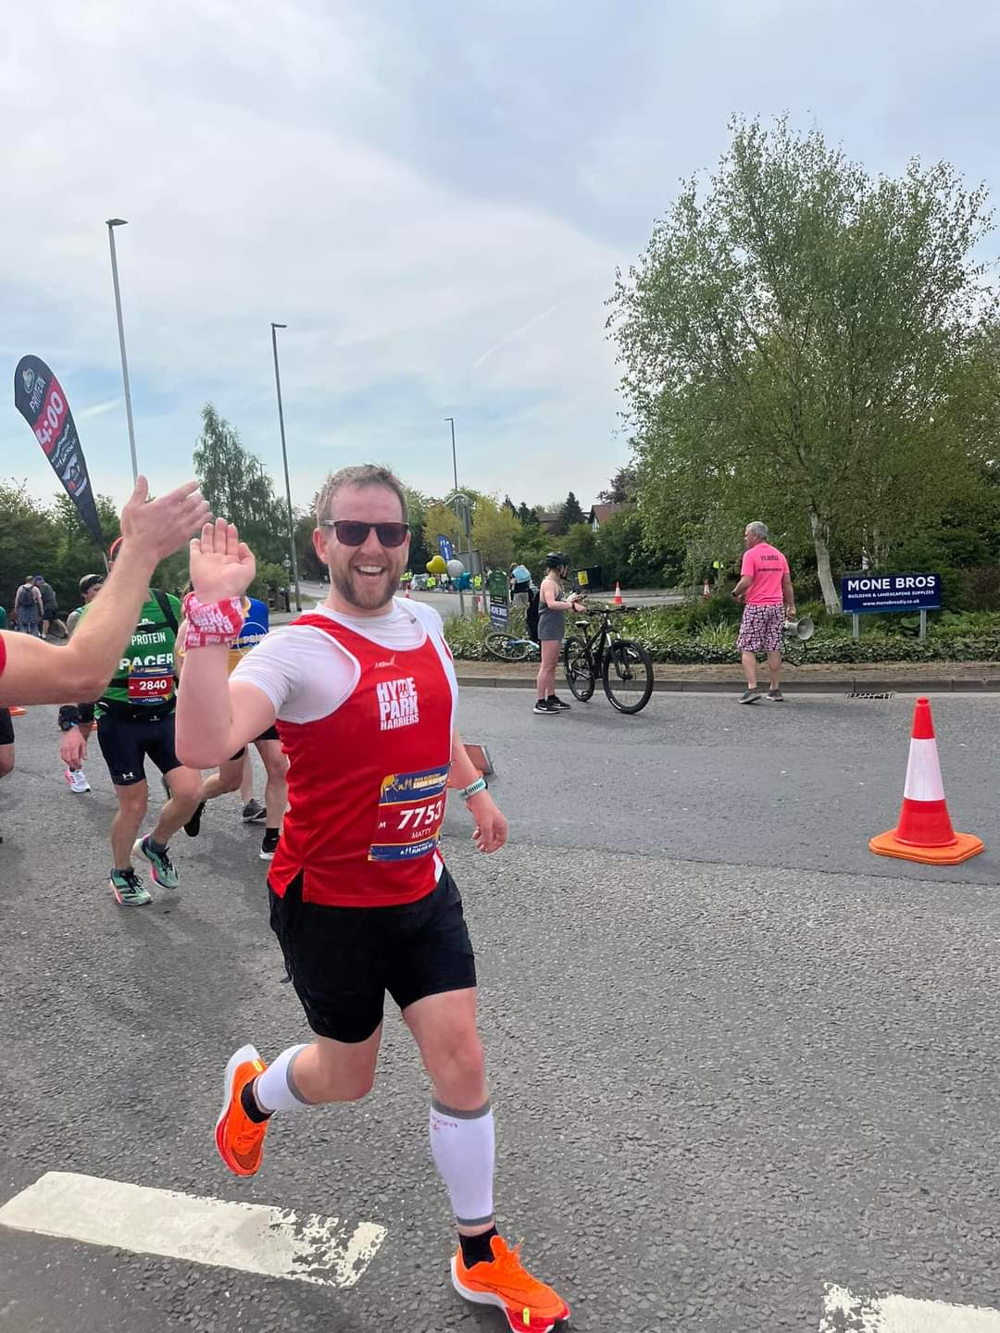
Musings of a Leeds GP
Dr Matt Barton
GP Partner & GP Trainer
Manor Park Surgery, Bramley, Leeds

Slide 2
Topics
The Current Plight of the NHS….
Is the NHS actually the National Sickness Service?
How can we improve the Nations Health?

Slide 3
Who works in the NHS?
Who has been affected by the NHS crisis?
What are thoughts about private providers?
How easy is it to get a GP appointment?????

Slide 4
Primary care and the NHS is a political tool
British population is getting iller – alongside increase in health anxiety
Increase in workload in specifically Primary Care
Society is struggling
Anger about excessive waiting times
Offloading of Secondary care work to GP when they are seen
NHS England work dump – eg plans to cancel hospital referral process
Access vs Demand
Patients being told access is a right…

Slide 7
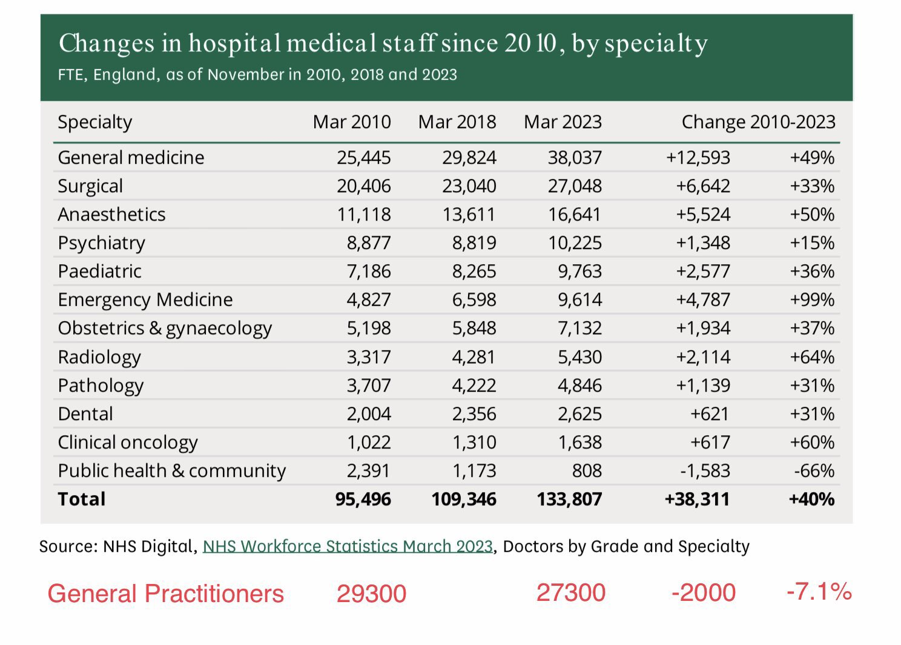
Not enough GP Staff?

Slide 8
Not enough GP Staff?
Cure
Prevention

Slide 11
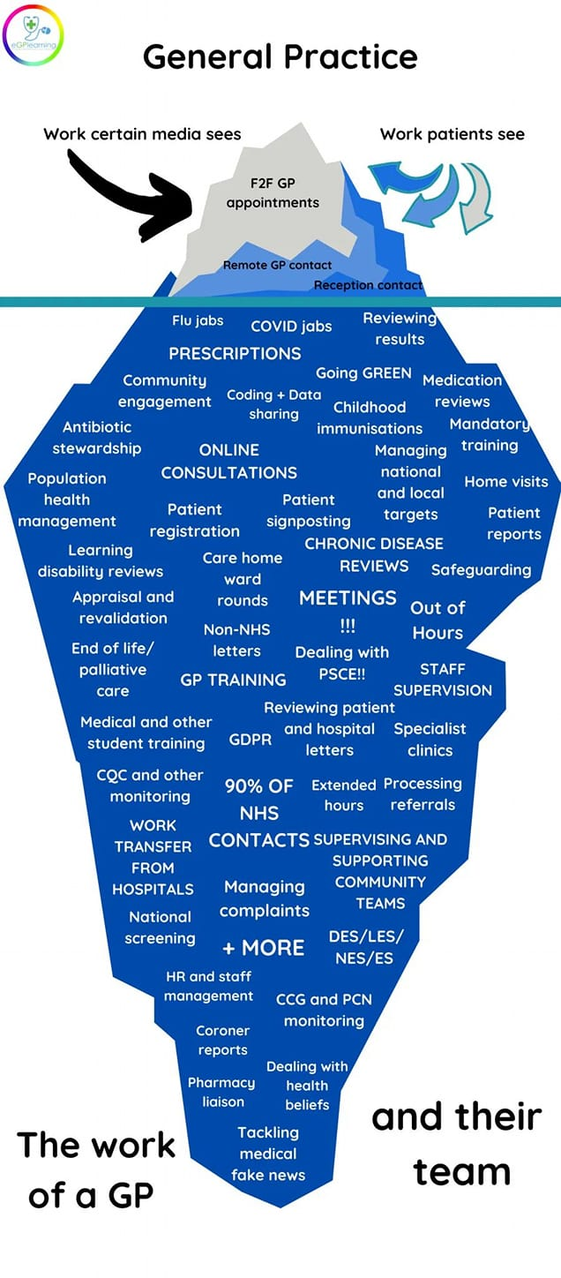

Slide 12
Funding
NHS SPENDING - PER PERSON £3400 ~ Total ~ £9.34/day
£1265 ~ NHS Hospital staff ~ £3.47/day 37%
£348 ~ NHS ‘Non-NHS Healthcare’ ~ 95p/day 10%
£302 ~ Medications ~ 83p/day 9% £163~ GP Services ~ 45p/day 5%
This should pay for ~ 70 GP appointments per 1000 patients per week
Equivalent to roughly 3.5 GP appointments per year per person
www.bma.org.uk/advice-and-support/nhs-delivery-and-workforce

Slide 14
Reduced hospital beds

Slide 15
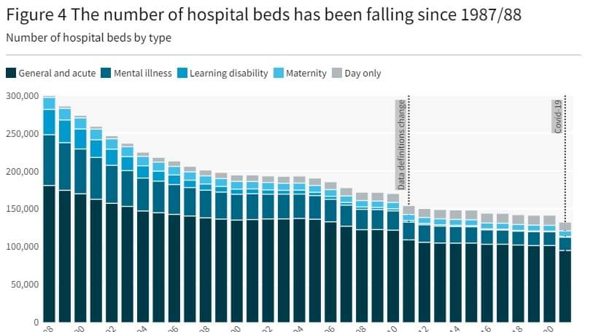

Slide 17
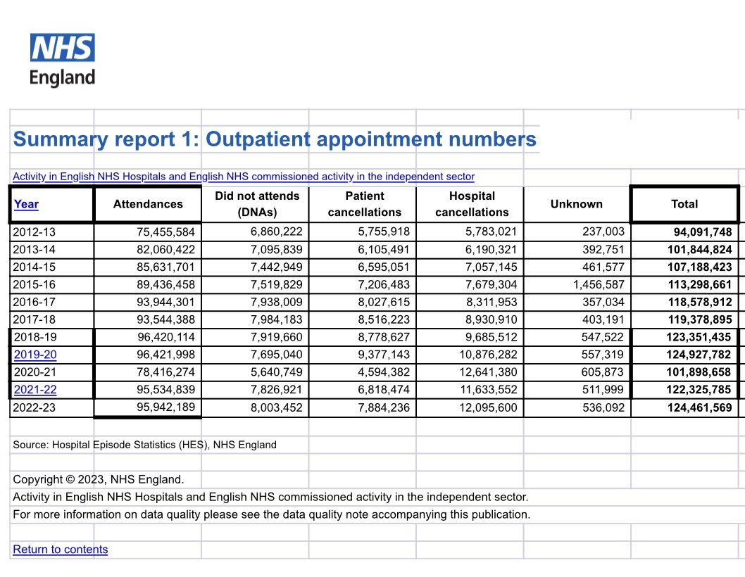

Slide 18
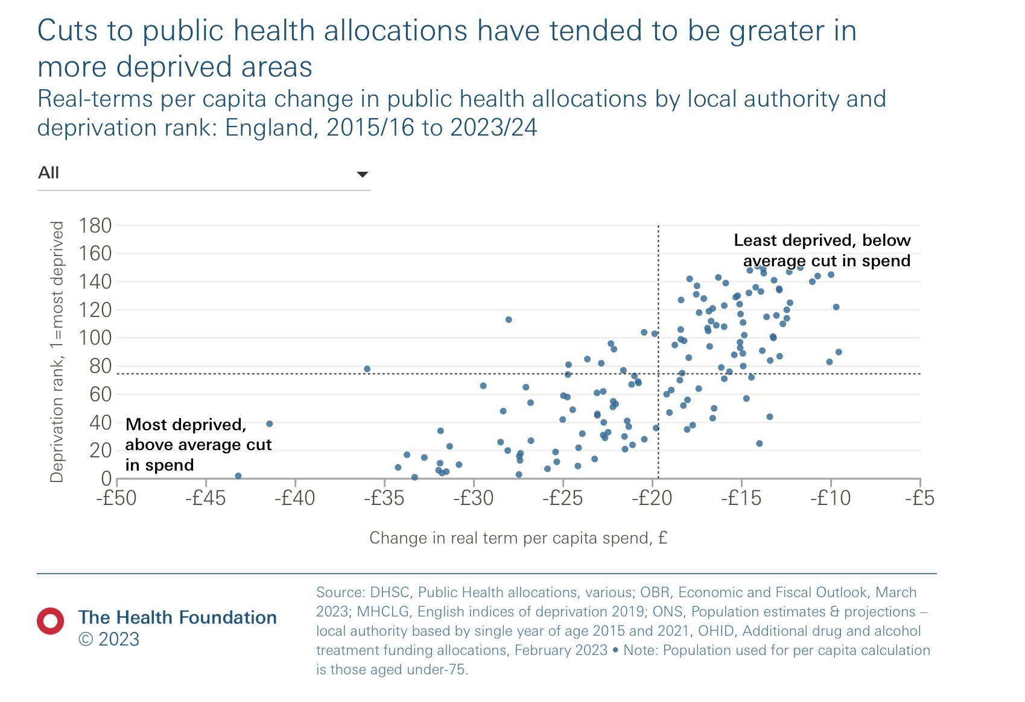
It's worse if you are deprived

Slide 19
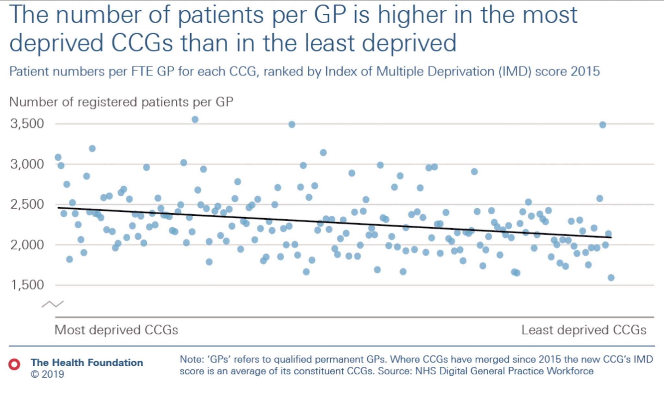

Slide 20
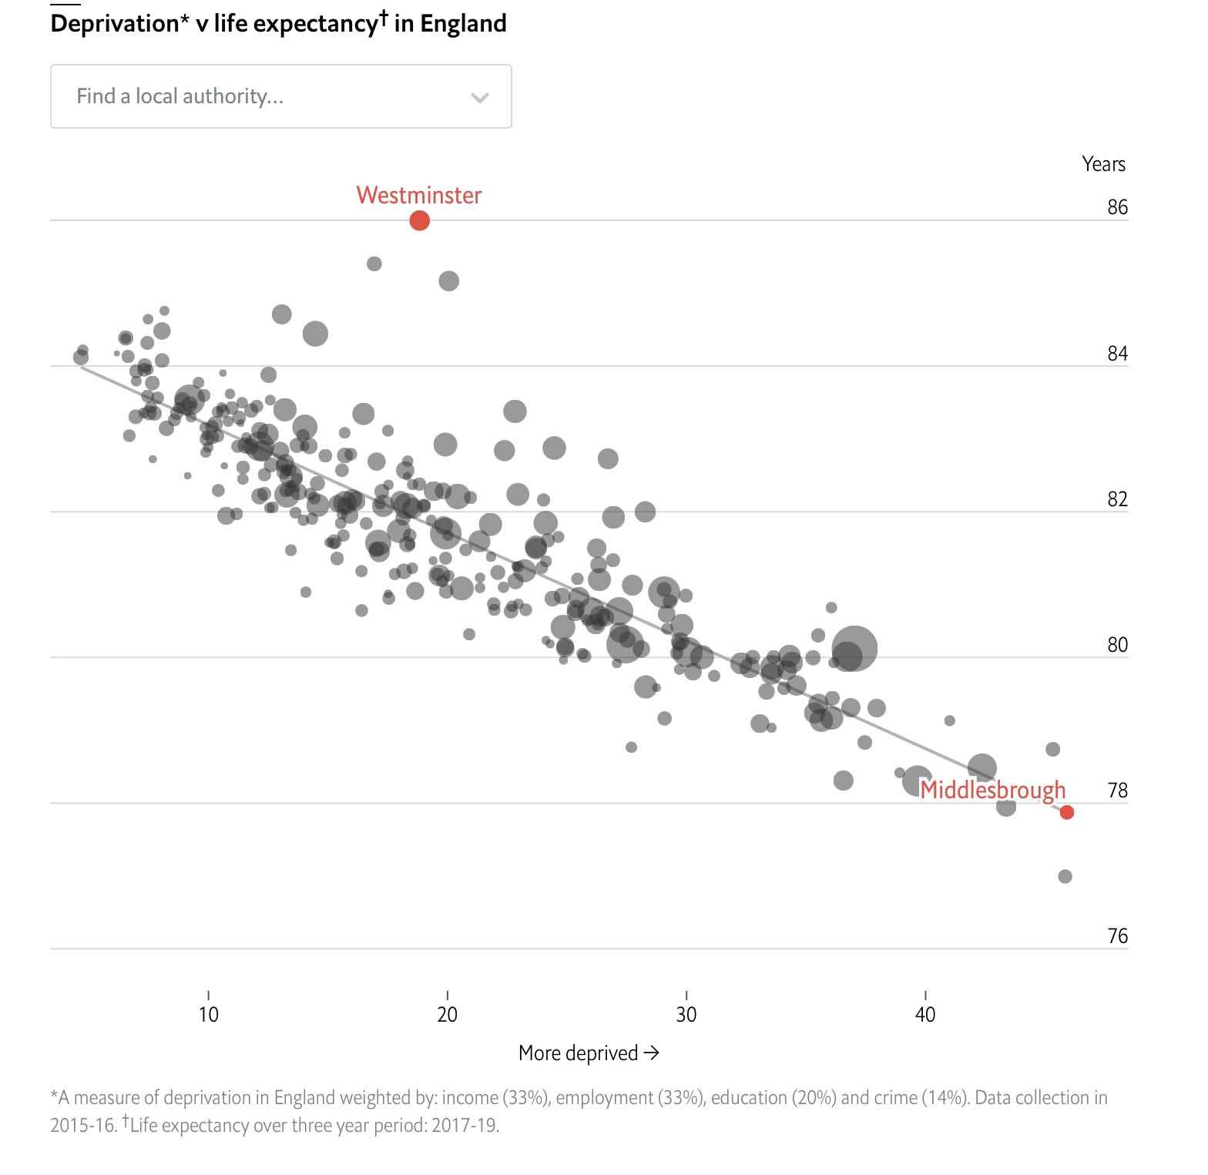

Slide 21
Why are we getting iller???

Slide 22
Why are we getting iller?
Infections & trauma killed most homo sapiens for the first 300000yrs
Vaccination
Sanitation
Antibiotics
Hygiene
Surgical knowledge

Slide 23
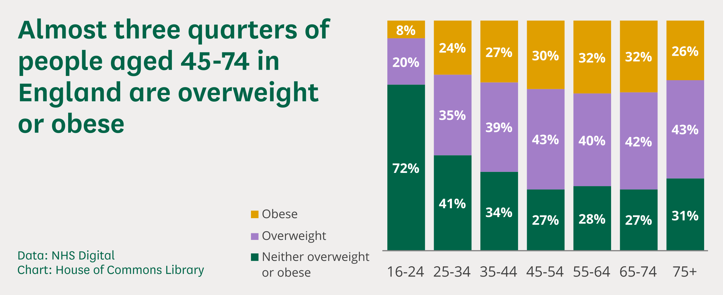
Is obesity the problem or the canary

Slide 24
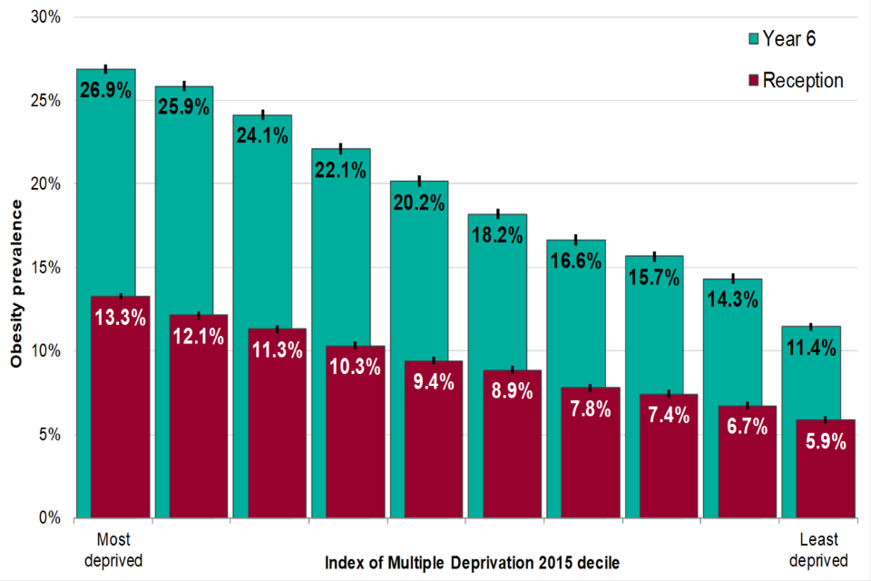

Slide 25
Obesity is simply a symptom of Stress: Psychological, Biological & social
Deprivation, Poverty, Poor housing, Racism, Misogyny, Noise, Pollution, Urban environments
Lack of purpose; Ill health, Grief, DVA, Toxic relationships
Isolation; Past traumas; Abuse; Adverse Childhood Experiences
Mental load, financial, emotional burdens, caring for others, worries
Poor Americanised Diet: Sugar – Ultra processed foods
Sedentary lifestyle (labour saving devices): Sitting; Office work, Couch, TV, Indoor time etc
Inability to relax; Poor Sleep
Hyperstimulation: Tech, TV, Cell phones, Screen Time, Social media
Lack of Self Compassion: Guilt, Envy, Self criticism, Complaining
Negative coping mechanisms: Alcohol, Drugs, Smoking, Gambling, Work etc

Slide 26
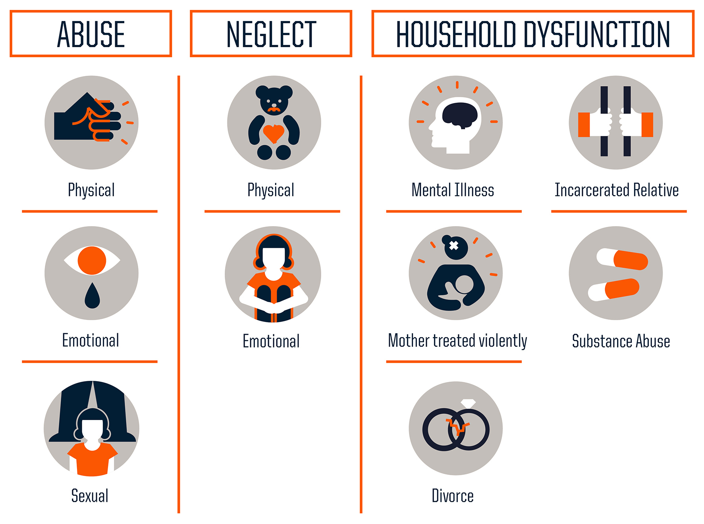
ACE Score
>4 increases the risk of heart disease 3-fold , Increased Risk Type 2 diabetes 4-fold, 6 times more likely to smoke, 14 times more likely to have experienced violence in the last 12 months
>6 life expectancy of 20 years less than those with a score of 0

Slide 27
95% of symptoms in GP are the Body working!
Your Brain Wants You To Be Anxious, Lazy & Fat - Dr Anders Hansen
Pain, Tiredness, Low Mood and Anxiety are a sign of chronic stress / ptsd
Obesity is a self defence mechanism for upcoming peril
Cough, aches, D&V, temperatures are the immune fighting bugs
Falls, back pains etc are more a sign of deconditioning than disease

Slide 28
Excess Sugar and Stress turns on the fight & flight response leading to disease
Obesity
Type 2 Diabetes
Ischaemic Heart Disease
Stroke
Hypertension
High cholesterol
Dental disease
Depression / Anxiety
Mental Health inc. Dementia
Cancer
PCOS/ subfertility
Autoimmune Disease
Atopic disease
Liver and Kidney Disease

Slide 29
LifeSPan is falling in the west, health Span is falling much more so!

Slide 30
Blue Zone project
Dan Buettner (National Geographic) went to areas with long healthy life spans
Okinawa, Japan
Loma Linda, California
Ikaria, Greece
Sardinia, Italy
Nicoya, Costa Rica
Serialised recently on Netflix "Live to 100"

Slide 31
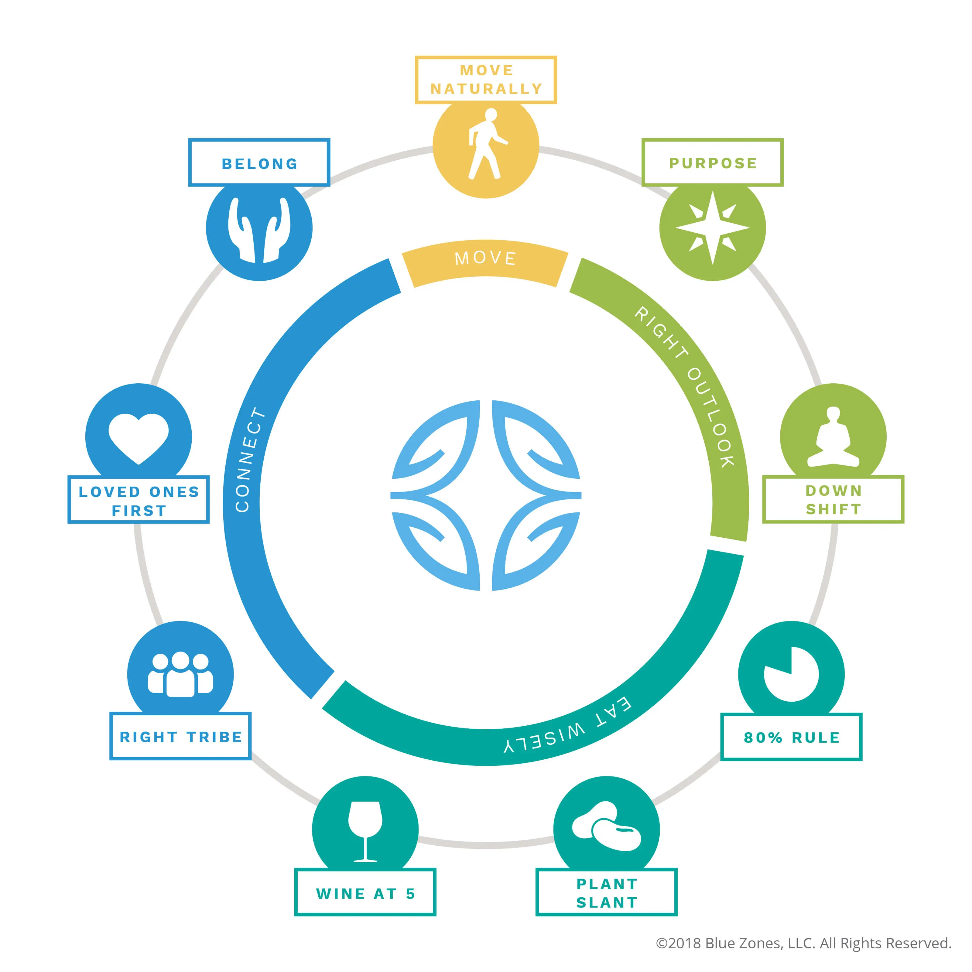

Slide 32
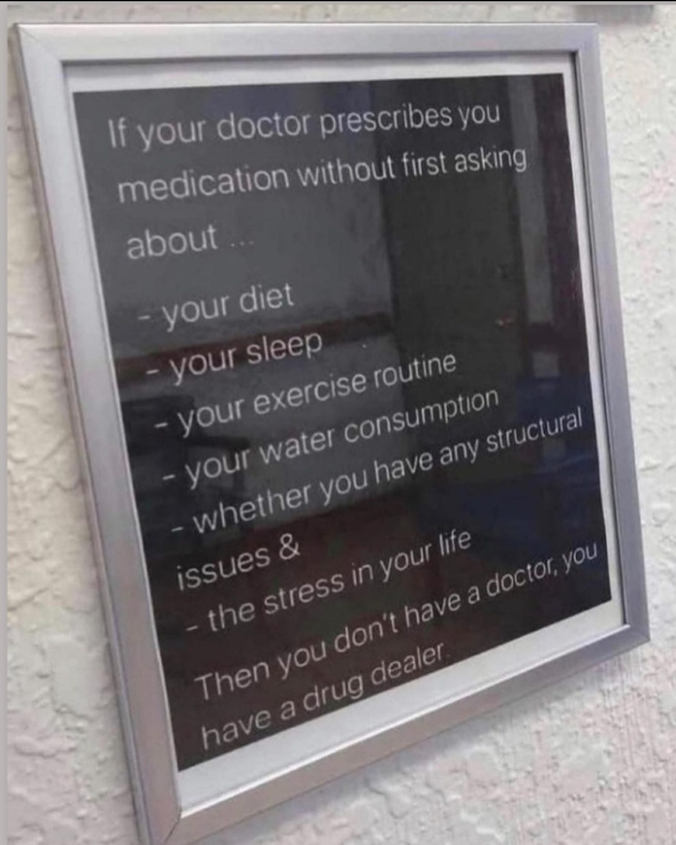
The Body Works!
Modern Reductionist medicine:
Symptoms
Disease
Management
Evidence Based Medicine
Drug
Holistic Care:
Life Experiences
Your self worth and place on the planet
Mental Fitness
Thoughts and emotions
Day to day behaviours
Physical health?
Symptoms

Slide 33
How do we create Health?
Health cannot be prescribed - It must be lived!
Nourish the brain and body within healthy societies so we can:
Have Good Relationships
Eat Real Whole Food
Priotise Regular Active Movement
Practice Active Relaxation
Feel Safe enough to have Real Sleep

Slide 34
How do we create Health?
GP's and the NHS cannot compensate, nor prescribe, for unhealthy lives!
Government must nurture society to create healthier places for healthy relationships
Government and society must make real food the easier, cheaper, more abundant option
Government and society must normalise movement
Government and society must normalise analogue relaxation
Only when this happens will our brains relax; let us sleep and let us live healthily!
For the sake of the country and our kids please…..
Only this will improve the health and save the economy of the nation!

Slide 35
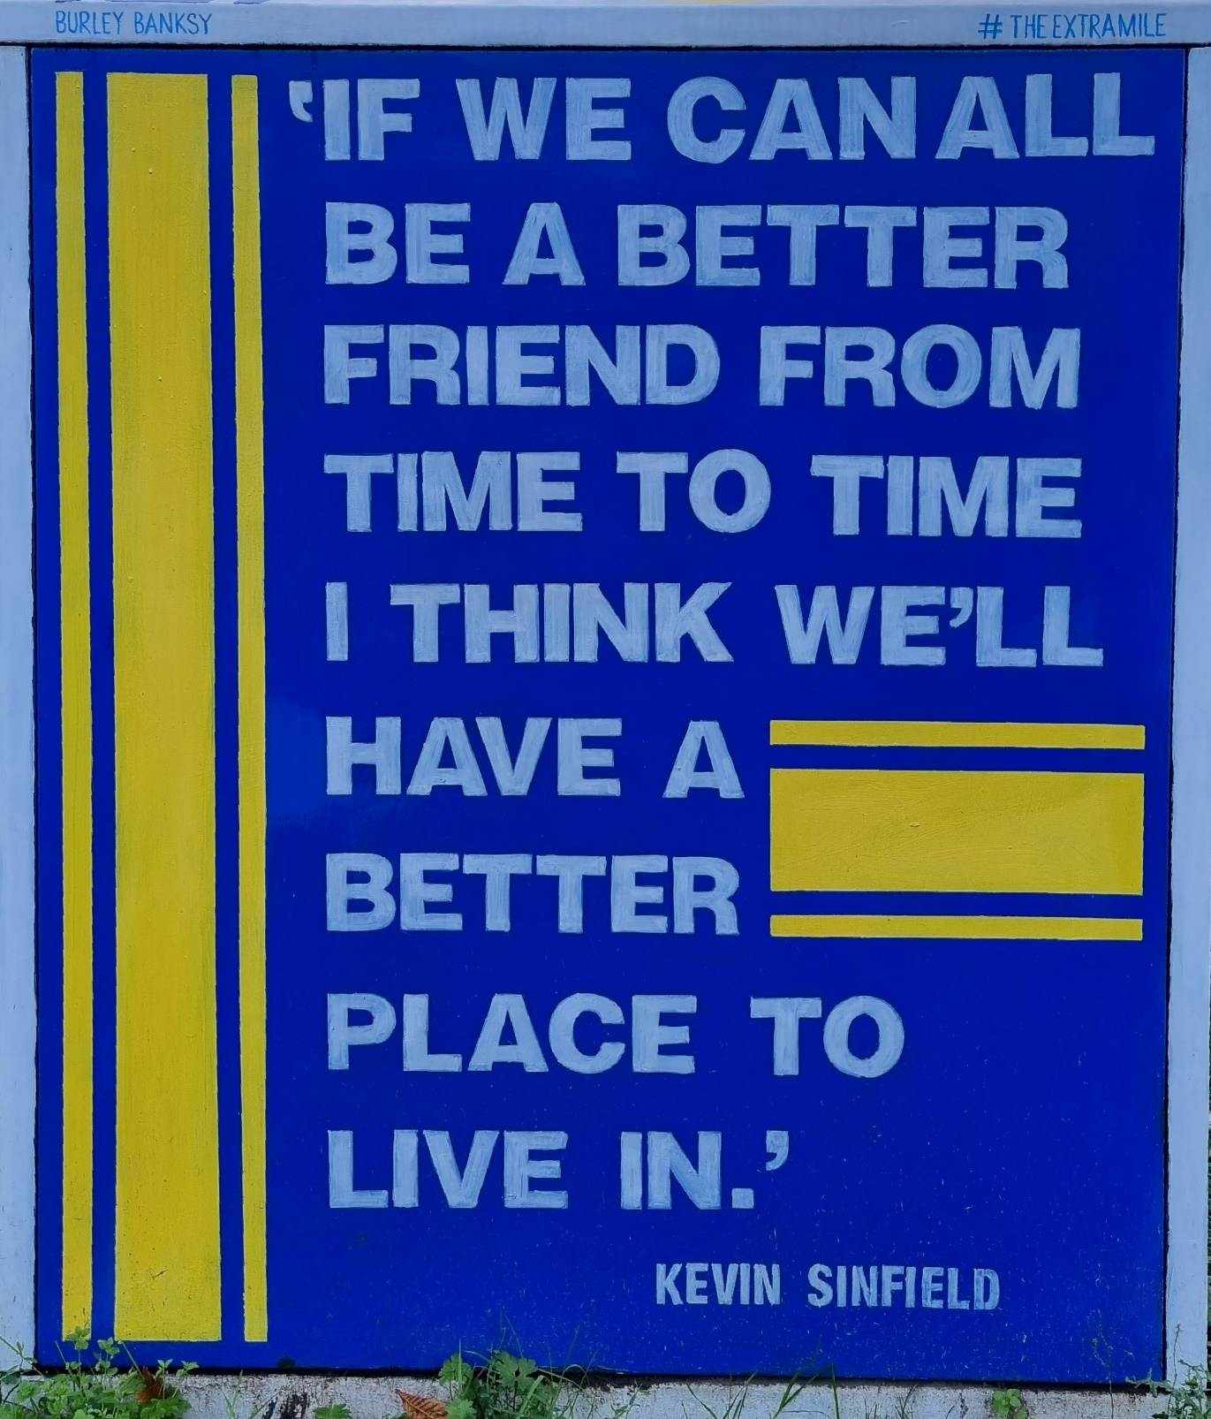
Further information / Reading:
Netflix: "Cooked" & "Live to 100"
Henry Dimbleby: Ravenous
Dr Chris van Tulleken: Ultra processed people
Prof Herman Pontzer: Burn
Prof Robert Lustig: Metabolical
Dr Mark Hyman: Food Fix & Young forever
Dr Rangan Chatterjee:
Podcast: Feel Better, Live More
Numerous Books inc: 4 Pillar plan & The Stress Solution.
Dr Chris Palmer: Brain Energy
Dr Gabor Mate: The Myth of Normal, & When the body says No
Dr Matthew Walker: Why we Sleep?
Dr Gabrielle Lyon: Forever Strong

