Slide 1
Public energy, private prices, global climate, and local jobs
- the economic and political dynamics of 21st century energy
David Hall
halldj@gmail.com , d.j.hall@gre.ac.uk
Visiting Professor and former Director
Public Services International Research Unit (PSIRU)
University of Greenwich, UK
March 2023

Slide 2
Summary
Context: history, socialism, capital, environment: political economy
Generation - moving to green energy, renewable generation, and replacing gas;
Prices - unbundled systems, markets, marginal/production costs, France & UK
Grids - monopolies, burden of profit extraction and lack of democratic efficiency;
Green new deal: creating quality, unionised jobs through green new deal inc. retrofitting
UK: the possibilities of a public-centered system and green new deal
This presentation has benefitted greatly from discussions over many years with colleagues at PSIRU (Vera Weghmann, Steve Thomas), We Own It (Pascale Robinson, Cat Hobbs), and others including Sean Sweeney (TUED), Jenny Nguyen (UCL-IIPP), Olivier Hoedeman (CEO), Lavinia Steinfort (TNI), David Boys, Jan Willem Goudriaan, Sandra van Niekerk(PSI), William Boyd (Labour for Green New Deal), Mika Minio-Paluello (TUC)

Slide 3
Context
History: long: kilns, smelting, wind/water wheel, sail
Industrial/fossil capitalism: mining, coal, gas, oil
  Markets for gas/elec: industrial, domestic, trams
Environmental impacts: mining, deforestation, smog, acid rain, carbon emissions, climate change
Social impacts: light, heat, cooking, washing machines, nightlife, travel, employment
So political economy dynamic of energy economics:
  Actors: business/capital, people, environment
  Relations: production, consumption, political
  Municipal ‘gas and water’ socialism ;
  ‘Communism = Soviet power plus electrification’ (Lenin, 1920)
  Neoliberal creation of ‘markets’
  ‘Just transition’

Slide 4
CO2 EMISSIONS |  | SOLUTIONS
 |  | Reduce consumption | Change production to renewables RE | Change systems to support RE
ENERGY PRODUCTION
Elec generated by coal, oil, gas, wood pellet |  |  | RE: wind, solar, hydro, geo, nuke | Storage : batteries, hydro
Gas: extraction of methane, propane |  |  | RE: green hydrogen | Refit pipes
ENERGY CONSUMPTION
Homes: heating/cooking light, phones, IT, TV with gas, oil, coal, wood, elec |  | Insulate homes Ban coal, wood fires | RE from grid Prosumer: solar, heat pumps, | District heating
Business/public : use of elec, gas, oil, for machines, IT, offices etc |  | insulation, efficiency; tax; carbon pricing? | RE from grid connections; prosumer/cogen | District heating Heat storage
Transport: cars, lorries, buses, trains, ships, planes: diesel, petrol |  | efficiency,WFH, supply chains, tax aviation fuel | Electric cars, trains (planes, lorries); sail ships | Public transport Car-charging infrastructure

Slide 5
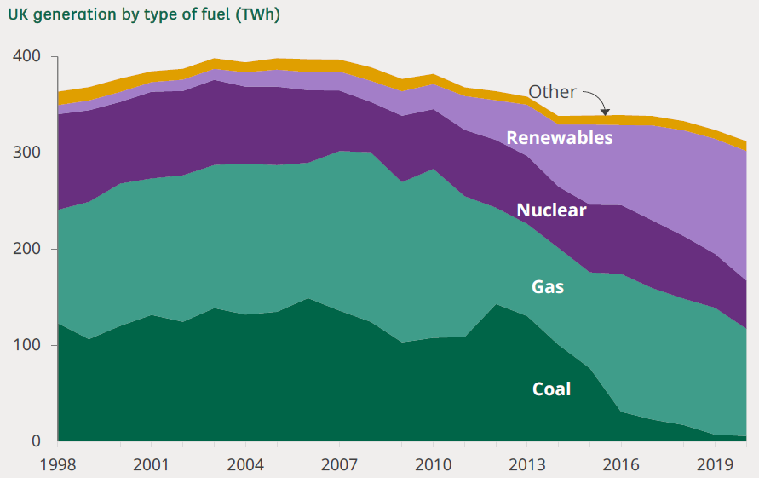
UK electricity generation: 20 year trends

Slide 6
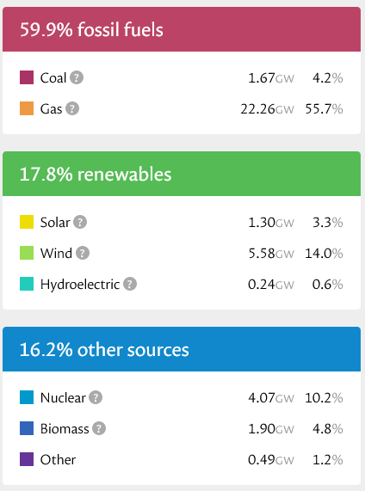
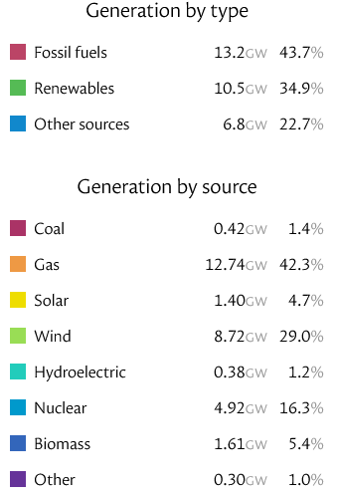
UK elec generation https://grid.iamkate.com/
Mon 6th March 2023
Full year March 2022-March 2023

Slide 7
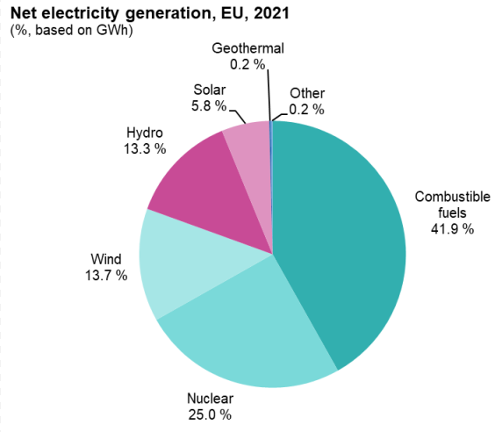
Generating electricity

Slide 8
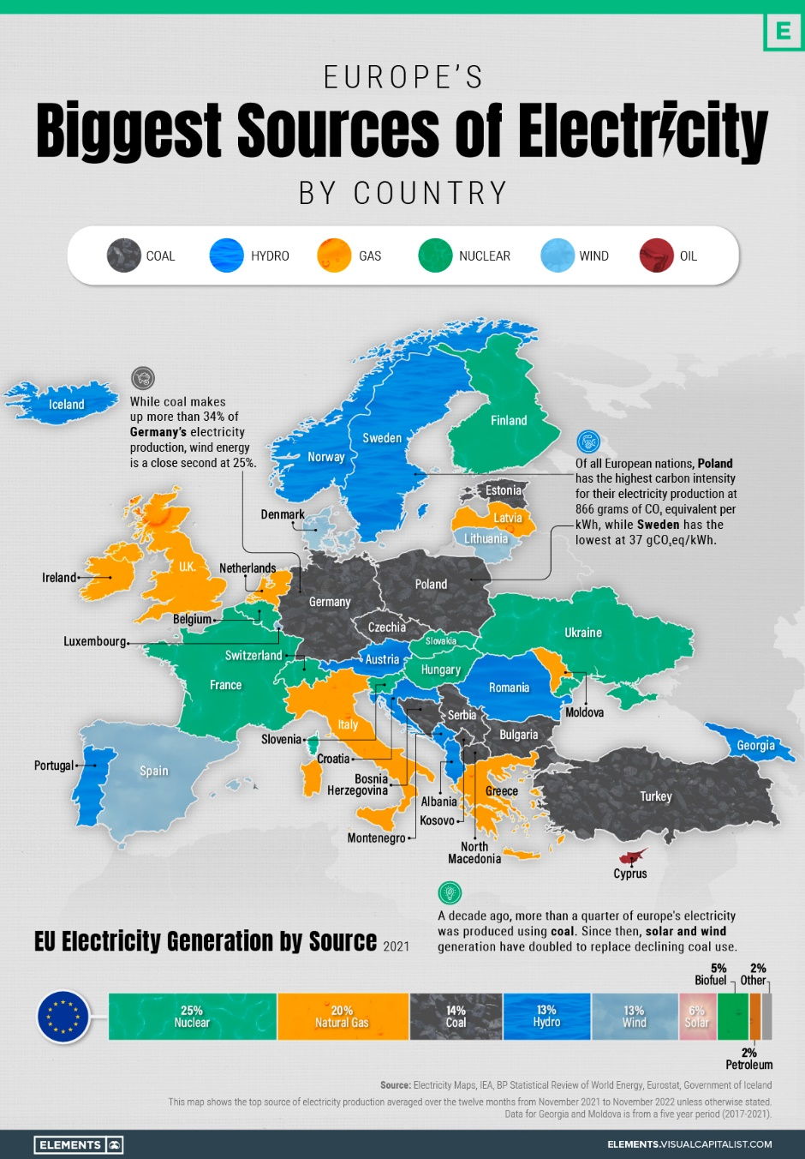

Slide 9
District heating (DH)
DH networks more efficient, can use RE eg geothermal
common in Europe
  64 pct. of household heat in Denmark, and 51% in Sweden.
  DH networks are natural monopolies: so in Denmark must be non-profit by law, so owned by municipalities or consumer coops; in Sweden, municipalities run 63% of DH systems
  so systems have public/democratic planning and regulation
UK slow on district heating
  problems include persistently low public awareness and “our obsession with privatisation”
  Just 480,000 consumers, on 14,000 heat networks, in UK,
  CCC: heat networks could supply 18% of UK heat by 2050
  UK Energy Security Bill : zoning & £338m. for developing heat networks,
  “The Energy Security Bill is an opportunity that cannot be squandered (ADE)”

Slide 10
Example of Munich: 100% municipal, 100% renewable
In 2011, Dieter Reiter, a Munich city councillor, now mayor, told an international conference of economists: (Reiter, Dieter 2011
  “Energy supply was one of the key sectors affected by privatization of formerly public enterprises. Today, energy supply is characterized by oligopolies of private energy suppliers. There is practically no competition on price. The transition to renewable energies is made rather reluctantly and only as a consequence of massive state subsidies and regulatory requirements .
  The example of Munich shows how the transition process can be sped up if a city owns a utility company. By 2025, our utility company aims to produce so much green energy, that the entire demand of the city can be met. That requires enormous investments – around 9 billion euros by 2025 – and can only be successful if the long-term goal is sustainable economic success rather than short-term profit maximization.”
Like many other German cities, Munich's municipality owns 100% a utility company Stadtwerke Munchen (SWM)
  SWM runs the energy distribution networks, generates electricity, and supplies energy, gas and district heating; runs the water and sewerage system; the public transport metro, bus, and bikes; telecomms and internet network; and swimming pools.

Slide 11
Stadtwerke Munchen (SWM) and climate change
SWM: A company for Munich ; SWM Annual Report 2021 ; SWM Sustainability report 2021
“In 2022, SWM will already generate some 6.3 billion kilowatt-hours of green electricity, covering approximately 90 % of Munich’s consumption" .
" From 2025, SWM intends to produce sufficient green electricity in its own plants to cover all of Munich’s requirements.
Because there is not enough space in Munich itself SWM has developed renewable electricity generation elsewhere in Germany and the rest of Europe: see map below.
Through SWM, the city is also addressing climate change by
  providing district heating using geothermal heat, to reduce use of gas,
  district cooling, to cut use of energy for air conditioning;
  And, because SWM also runs the city's public transport system -is changing the city's entire bus fleet to use of renewable electricity by 2035:

Slide 12
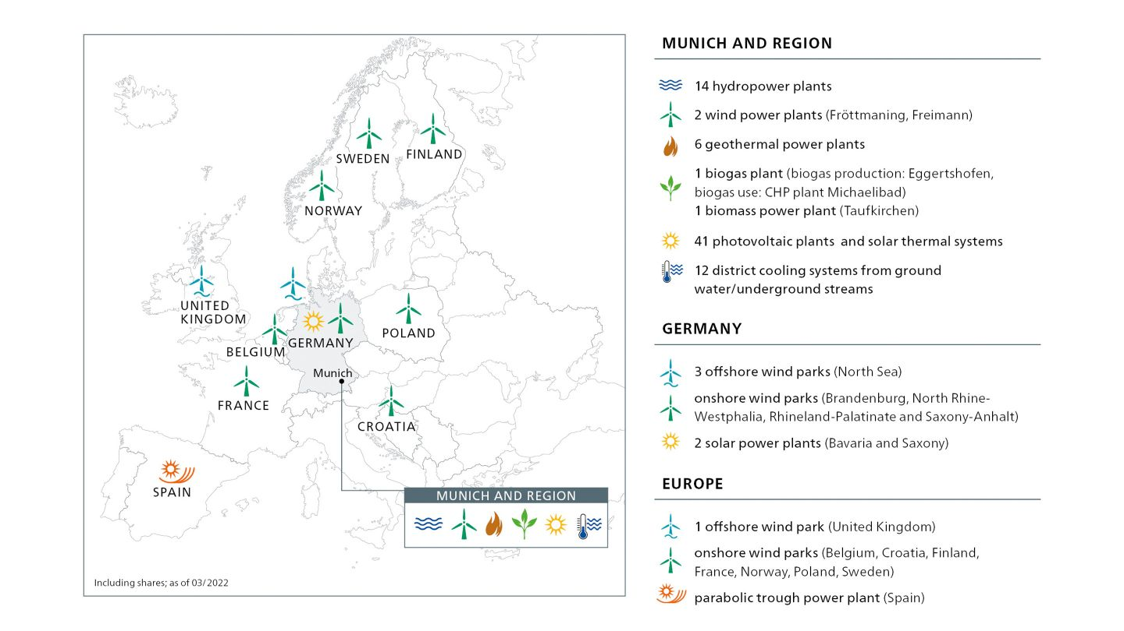
Munich’s SWM: public renewable energy
SWM: A company for Munich https://www.swm.de/english/company

Slide 13
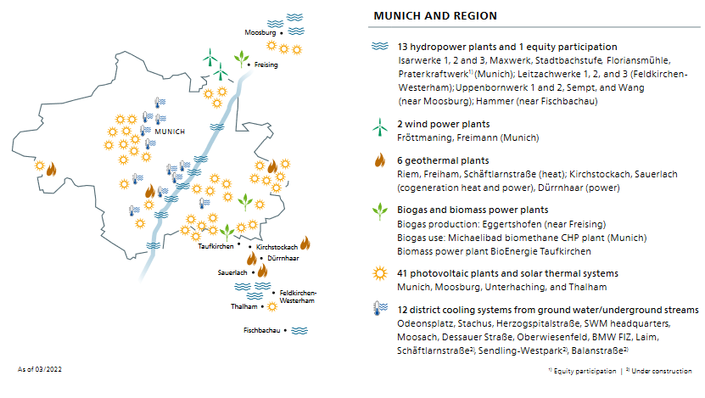
Munich’s SWM: heating, cooling
SWM Sustainability report 2021

Slide 14
2. Energy price rises in Europe
EU wholesale market magnifies problem of gas prices to renewable,nuclear electricity
  Energy wholesale market: price fixed by marginal cost
  But this is meaningless with renewables, marginal costs are zero
Policy responses have different impacts
  Consumer support guarantees high prices/profits to suppliers
  Taxing ‘excess profits’ hits renewable/nuclear generators though should be increased
  No tax/cap on other opportunistic price rises eg transmission/distribution surge in profits
Natural and direct response is via
  price caps based on actual production costs
  and/or public ownership at all points in the chain
  but EU/countries desperately want to maintain markets and private

Slide 15
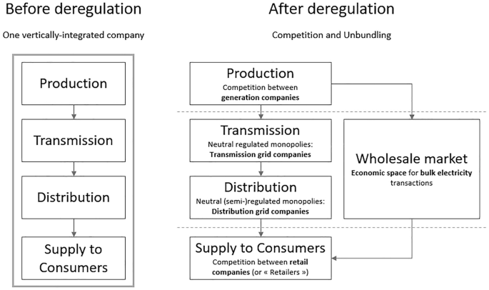
Electricity market system: unbundled/disintegrated

Slide 16
France and price controls
The electricity sector in France remains dominated by EdF, which is responsible for a very high proportion of generation - mainly nuclear power stations - runs the networks (through arms length subsidiary Enedis) and dominates the supply market, with over 70% of the retail market. EdF gained an extra 500,000 customers in the last year, and now has 26.2 million customers.
The French government is now buying the remaining private shares in the company so it will be 100% state-owned.
The French government announced a price cap of 4% on electricity supply companies in January 2022, to protect against the surge on energy wholesale prices.
Retailers were not themselves forced to carry the consequent losses, as the government also instructed EdF's generating business to continue selling electricity to all suppliers at existing price levels, basically at the cost of production.
EdF did not make extra losses as a result of this cap, but was prevented from making windfall profits by raising its prices to the wholesale market levels.
  https://www.statista.com/statistics/752890/market-share-electricity-suppliers-france-by-market-segments/
  Reuters 29 June 2022French power company EDF won over more retail clients since last August
  https://www.reuters.com/business/energy/french-power-company-edf-eyes-doubling-energy-services-units-ebitda-by-2030-2022-06-29/
  https://www.ft.com/content/36a20ace-7c6a-4dd8-b270-372a37f5aa53 ;

Slide 17
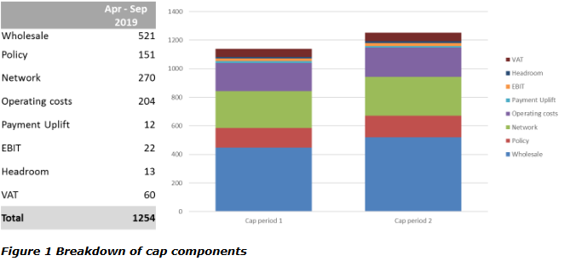
Retail price cap: cost-plus regulation

Slide 18
Previous example: California 2000: cartel fixes prices
1990s laws encourage unbundling and liberalisation
Early shock of California blackouts and price spikes 2000
  Due to “suppliers exercising market power” (Joskow/Kahn 2002)
  Only Los Angeles escapes: retained vertically integrated municipal monopoly, so no cuts
Trend halted and then reversed
prices rose faster where markets had been introduced
  Texas towns complain that 10 years of markets led to “spiralling electricity prices, abuses in the wholesale power market and reduced profits for [local, non-electrical] businesses”
  Higher prices linked to higher returns on capital
Large industrial consumers now oppose unbundling and de-regulation because prices are too high
  “the structure of today’s ‘organized markets’ is neither competitive nor sustainable” (Andersen 2009)

Slide 19
USA: most states reject retail competition
Source: USA Government EIA. Sept 2009. http://www.eia.doe.gov/cneaf/electricity/chg_str/restructure.pdf

Slide 20
3. Grids: monopolies, profits, democracy, management
Electric: transmission national, distribution regional
  ‘Natural monopolies’ – JS Mill: no competition, so excess profits, also sunk costs – so public ownership
UK grids prove Mill right: profits £6.3bn 2021
  " UK gas and electricity distribution companies have higher profit margins than any other sector…elec 42.5%, gas 40.5%.”
  2017-2021 dividends+buybacks: elec grids £3.6bn, gas £2.4bn, Nat Grid £9bn.
Public ownership of grids still normal in Europe
  Only UK, Hungary, Bulgaria 100% private and 100% foreign
  Netherlands: gas and elec grids, transmission and distribution, MUST be public (Electricity Act 1998, Gas Act 2008: private ownership is prohibited. Legality confirmed by CJEU Essent 2013 .

Slide 21
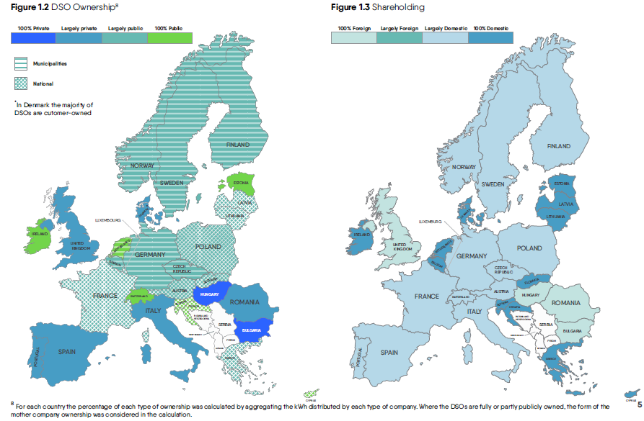
Public/private ownership of grids in EU 2021
Eurelectric: Distribution grids in Europe Facts and Figures 2020

Slide 22
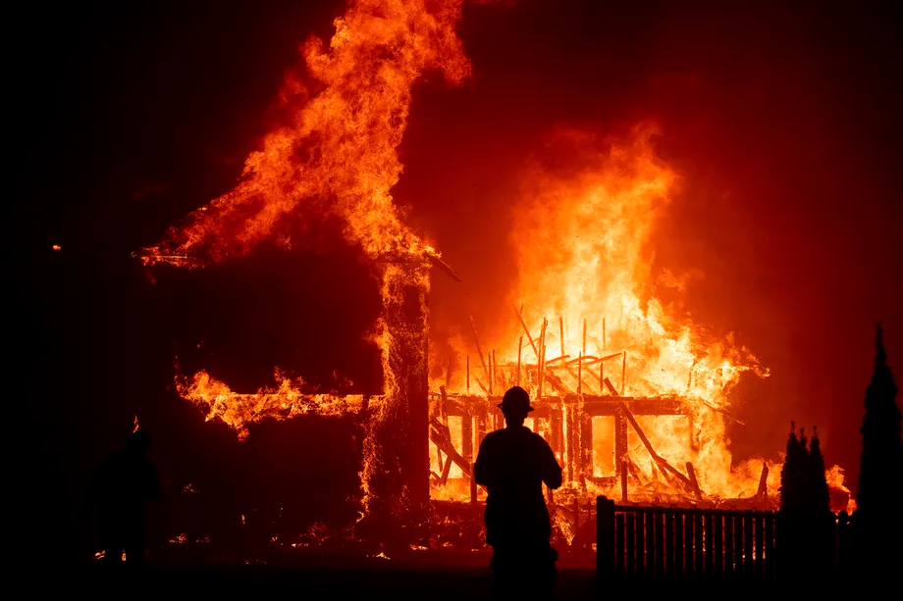
Grids: connection, competence
Universal connections including rural areas and urban poor is key part of nation-building
  Brazil ‘luz para todos’, South Africa post-apartheid rural expansion, USA new deal, Ireland, France EdF, USSR +
  India Saubhagya near 100%
  Cf Nigeria (200m.): only 57% connected ; Uganda only 19% despite $100m. loan
“countries with the national utility responsible for extending the grid, have been more successful than …attempts to recruit multiple utilities or private companies” (WB report 2010)
Poor grid maintenance causes California fires
The Dixie Fire, the second-largest wildfire in California’s history, was sparked when power lines owned by Pacific Gas and Electric (PG&E) came into contact with a tree
PG&E were held responsible for sparking the state’s deadliest wildfire, the Camp Fire that killed 85 people in 2018: regulators too lenient on plans . PG&E goes bankrupt over damages (previously bankrupt over drought and debt 2001).
“parallels between the circumstances that led to a large pipeline explosion in 2010 south of San Francisco, when a PG&E gas transmission pipeline exploded in the middle of a neighborhood - a jury later convicted PG&E of deliberately violating pipeline safety regulations before the explosion in the San Francisco Bay Area, and then misleading investigators looking into the blast - and the 2018 Camp Fire when a transmission line failed….. inherent tension between private interests in delivering for shareholders and the public good.“California Burning.

Slide 23
Grids: greater management role with RE
Networks new role in planning RE transition
  Dieter Helm: "The net zero 2035 target: the gap between where we are and where the power sector needs to be in 12 years’ time is enormous. It is a no-brainer that there needs to be an integrated system plan to get from here to there, and the networks are core to achieving this.“
New solar and wind generation connection
  UK DSOs fail badly: "Renewables groups sound alarm over UK grid connection delays Solar, wind and battery storage developers say 13-year wait threatens investment and Britain’s net zero goals" FT Feb 6 2023
Smart meters:
  UK wrongly links to suppliers not grid: “Instead of a smooth street-by-street conversion into properly smart meters – which lots of other countries have achieved –the UK has been slow and incredibly expensive. It is a massive regulatory mistake that has led to this outcome”
  Cf Germany: “Smart meters form part of the digital infrastructure and are therefore an essential element of a close to zero emissions energy system characterised by fluctuating demand and volatile generation… From 2025, all electricity suppliers – no matter their number of customers – are required to offer dynamic tariffs… the act will strengthen the possibility to install the smart meter gateway – the smart meter’s secure communication unit – at the grid connection point [which] will make it possible to group together several different consumers/charging units at the grid connection point, which can then operate on the market independently. The grouping is also more sustainable as fewer meters need to be installed....”

Slide 24
Grids: electric vehicle charging
UK: not enough and no clear strategy
  " ... as of 1 January 2023, there were 37,055 public electric charging devices installed in the UK, ...Without enough chargepoints EV ownership is not practical. There is currently some uncertainty as to how many EV chargepoints are needed, and where they should be located – at home, on the road network, in streetlamps” (HoC Library Jan 3, 2023.
Netherlands by contrast:
  “has the greatest density of chargepoints in Europe at 2,940 chargers per million population”; by end 2022 there were 69,804 public charging points 24/7, and 49,393 semi-public.
  Key role of municipalities and publicly owned distribution grids (DSOs): a very specific stakeholder ecosystem in which collaboration is key. Initially, almost all public EV chargers in the Netherlands were developed by EVnetNL, an initiative of the Dutch [public sector] DSOs
  “DSOs [all public sector] operate a collaborative knowledge platform ... provinces, regions and municipalities structure their own programs for EV charging ... use demand-driven approaches built around the Dutch ‘right-to-charge’ and involve close collaboration .. to ensure the relevant EV charging data flows to all parties .
  "In the Amsterdam concession the company that installs the charge points (Nuon-Heijmans) and the DSO (Liander) struck an agreement specifying that Nuon-Heijmans was allowed to connect the charge points directly to the electricity grid, without the need for DSO intervention This significantly reduces the overall lead time of placing and connecting a charge point"

Slide 25
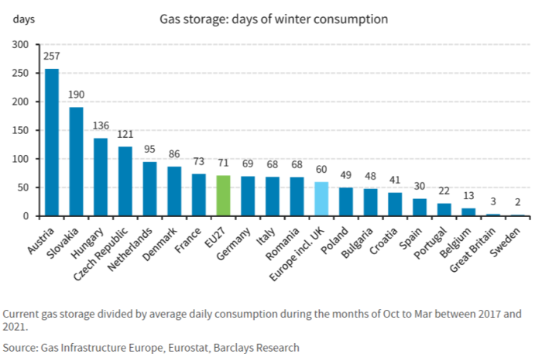
Gas: grids, ‘green’ hydrogen, storage
UK gas grids: now mostly owned by Macquarie
  Also owns metering company
UK (and EU): use ‘green’ hydrogen to replace gas
  UK plans 20% hydrogen mix in gas by 2025; extend network to link to hydrogen factories
Gas storage: lowest in Europe, companies unhelpful
  “SSE pushed up its full-year profit forecast after its gas-fired plants and storage sites benefited from higher prices…. SSE owns 40 % of the UK’s onshore gas storage facilities, most of which is based in underground caverns in Yorkshire. .” (Jan 2023)
  Centrica refuses to prolong Rough storage capacity (Feb 2023)

Slide 26
4. Retrofitting and green jobs
Insulation/retrofitting still vital for domestic heating
  gas will take long-time to replace; hydrogen uncertain substitute; simple switch to electric not efficient; district heating relies on local initiatives, so partial
  social reasons: to make homes warmer, improve public health, and reduce energy costs, especially for poor in older housing, while also reducing carbon emissions
Municipal/university/union plans and campaigns
  NEF 5-point programme, including “Create and fund a national retrofit taskforce”, extra £11.7bn investment
  Need to “develop a social and labour-centred approach to retrofitting, one that provides proper training and future employment for young people and good quality, low-energy housing. It showed how retrofitting and improving the quality of social housing go together with transforming the construction VET system, the construction labour process and employment relations and that the first step in achieving this is to set up retrofit taskforces in each local area.“
  Greener Jobs Alliance ; Unite the Union’s North-East Yorkshire & Humber (NEYH) Retrofitting of Homes Taskforce, and call for “an inhouse direct workforce”
Note NZ booklet with plan for Ministry of Green Works

Slide 27
5. Planning, efficiency, and the future?
New government Energy Bill 2022 (Boris and still..)
  Creates Future System Operator (FSO)
  by nationalizing parts of National Grid
“operating, planning and co-ordinating the system
  to drive net zero outcomes by proactively identifying and creating opportunities to facilitate the transition…
  security of supply of electricity and gas
  promoting an efficient, a coordinated and economical electricity and gas system. Joining these planning functions is expected to result in an increased potential for efficiencies”
Note also government stake in new nuclear plants

Slide 28
Reasons for moving public:
Energy price crisis
  France shows simple alternative of public ownership of system: just fix EdF prices, generate via non-thermal
  4% cap for public objectives > private shareholders sell
Need for stronger policy leadership from national government and from grids/DSOs
Public sector far more likely to invest in renewables
  Eg Arup etc demand government investment for geothermal energy

Slide 29
UK: Huge 3-1 public support for public ownership of energy
We Own It (16 August 2022) Biggest ever poll shows huge support for nationalisation (survey of 4,396 people, by Survation)

Slide 30
A possible system
source: Designing Future Public Ownership TNI 2022

Slide 31
Sources
Hvelplund, Frede, and Søren Djørup. “Consumer Ownership, Natural Monopolies and Transition to 100% Renewable Energy Systems.” Energy 181 (August 2019): 440–49 https://doi.org/10.1016/j.energy.2019.05.058.
Rosenlund Soysal, Emilie, and Frede Hvelplund, Finn Arler, Henrik Lund. “Price Efficiency, Green Transition and Channels for Regulating Natural Monopolies: The Case of the Distribution System Operators (DSOs).” Danish Utility Regulator’s Anthology Project Series on Better Regulation in the Energy Sector: Energy Regulation in the Green Transition 1, no. 1 (March 15, 2021). https://doi.org/10.51138/BZYB4621.
We Own It (16 August 2022) Biggest ever poll shows huge support for nationalisation (survey of 4,396 people, by Survation) https://weownit.org.uk/blog/biggest-ever-poll-shows-huge-support-nationalisation
Gabor, Daniela and Ndongo Samba Sylla. “Dreams of Green Hydrogen.” Boston Review. 17 January 2023. https://www.bostonreview.net/articles/dreams-of-green-hydrogen/.
Financial Times. “Gas and Electricity Networks Top UK Profit Margin Rankings,” March 14, 2022. https://www.ft.com/content/aff47fb4-34ec-49c7-8aca-ebd462f4142b
Inman, Phillip. ‘Put All of National Grid under State Control, Net Zero Campaigners Urge’. The Guardian, 15 January 2023, sec. Business. https://www.theguardian.com/business/2023/jan/15/put-all-of-national-grid-under-state-control-net-zero-campaigners-urge.
Eurelectric. ‘Distribution Grids in Europe Facts and Figures 20’, 2020. https://www3.eurelectric.org/powerdistributionineurope/
How power companies have caused and worsened wildfires: “California Burning” author Katherine Blunt on the lessons learned in California. Vox Sep 13, 2022 https://www.vox.com/science-and-health/2022/9/13/23345164/california-wildfires-heat-blackouts-burning
World Bank/AFD 2010 Africa’s Infrastructure 2010 http://www.infrastructureafrica.org/aicd/system/files/AIATT_Consolidated_smaller.pdf
Baines, Joseph, and Sandy Brian Hager. ‘Profiting Amid the Energy Crisis’:, n.d. https://www.common-wealth.co.uk/publications/profiting-amid-the-crisis.
Dieter Helm. Energy blog http://www.dieterhelm.co.uk/

Slide 32
BMWK-Federal Ministry for Economics Affairs and Climate. ‘The Cabinet Adopts Relaunch of the Digitisation of the Energy Transition and Paves the Way for Accelerated Smart Meter Rollout’. Accessed 5 March 2023. https://www.bmwk.de/Redaktion/EN/Pressemitteilungen/2023/01/20230111-the-cabinet-adopts-relaunch-of-the-digitisation-of-the-energy-transition-and-paves-the-way-for-accelerated-smart-meter-rollout.html.
HoC Library. “Electric Vehicles and Infrastructure,” June 3, 2023. https://commonslibrary.parliament.uk/research-briefings/cbp-7480/.
Guidehouse Nov 2021 Lessons from the Dutch EV charging approach https://www.transformative-mobility.org/assets/site/2111-SSE_COP26_EV-Paper_Guidehouse.pdf
FT 05 Feb 2023 Breakdown of gas storage talks leaves UK exposed to price surges, say experts https://www.ft.com/content/0ebf0cf1-af77-4670-90d6-ec060fd94f66
Financial Times. “Energy Group SSE Lifts Profit Forecast after Prices Surge,” January 20, 2023. https://www.ft.com/content/a6456d04-3581-422b-9971-4b9d288beb4e
GOV.UK. ‘Energy Security Bill Factsheet: Future System Operator’. Accessed 7 March 2023. https://www.gov.uk/government/publications/energy-security-bill-factsheets/energy-security-bill-factsheet-future-system-operator.
Gorroño-Albizu, Leire, and Jaqueline de Godoy. “Getting Fair Institutional Conditions for District Heating Consumers: Insights from Denmark and Sweden.” Energy 237 (December 15, 2021): 121615. https://doi.org/10.1016/j.energy.2021.121615
Reiter, Dieter 2011 Welcome address to 10th Munich Economic Summit 19–20 May 2011. P.3 http://www.cesifo-group.de/DocDL/Forum-3-2011.pdf
SWM: A company for Munich https://www.swm.de/english/company . See also Stadtwerke München Annual Report 2021 https://www.swm.de/dam/doc/english/swm-annual-report.pdf
Avanzini et al. “Energy Retrofit as an Answer to Public Health Costs of Fuel Poverty in Lisbon Social Housing.” Energy Policy 160 (Jan 1, 2022): https://doi.org/10.1016/j.enpol.2021.112658.
Ministry of Green Works for NZ 2021 - https://apo.org.au/sites/default/files/resource-files/2021-10/apo-nid315499.pdf

