Slide 1
Asylum policy in the UK:
how communities can fight the anti-refugee laws
June 2023
Mary Brandon, Asylum Matters

Slide 2
Background
In 2022, the top five countries of origin of people seeking asylum were Iran, Albania, Iraq, Afghanistan, and Syria.
89,398 people claimed asylum in the UK in 2022
In terms of the number of asylum applications per head of population, the UK ranks
Recognition rates:
of initial decisions are grants of protection
of asylum appeals are allowed
20th highest in Europe.
75%
44%
Notes:
Stats from Ref Council: https://www.refugeecouncil.org.uk/information/refugee-asylum-facts/top-10-facts-about-refugees-and-people-seeking-asylum/
There were 74,751 asylum applications (relating to 89,398 people) in the UK in 2022, a 49% increase from 2021. The increase in applications is likely to be due to the continued global increase in the number of people displaced due to war and conflict.

Slide 3
Decision making has stalled…
In 2014, nine in 10 applications received an initial decision within ten months. In 2022, only one in 10 did.
and wait times are increasing:
There is a record backlog of 160,919 people waiting for a decision.
At the end of 2022, 109,641 people had been waiting more than six months for a decision on their claim
Profound impact on mental health
Notes:
https://www.refugeecouncil.org.uk/information/refugee-asylum-facts/top-10-facts-about-refugees-and-people-seeking-asylum/

Slide 4
While people are waiting:
People dispersed on no-choice basis
Increasing number of people in harmful ‘contingency’ accommodation: 50,000+
Support levels remain very low: £45 per week, £9.10 if living in a hotel
Very limited access to employment; can only work if waiting for 1 year and in a role on the shortage occupation list: effectively a ban on working

Slide 5
Very limited safe routes to UK
Resettlement, including community sponsorship; ‘bespoke’ schemes; family reunion.
Afghans were among the top nationalities using small boats to reach the UK in 2022, while Ukrainians—one of the only groups of refugees who can travel to the UK on a visa to seek safety—were absent from the small boat statistics
Notes:
https://www.refugeecouncil.org.uk/information/refugee-asylum-facts/top-10-facts-about-refugees-and-people-seeking-asylum/

Slide 6
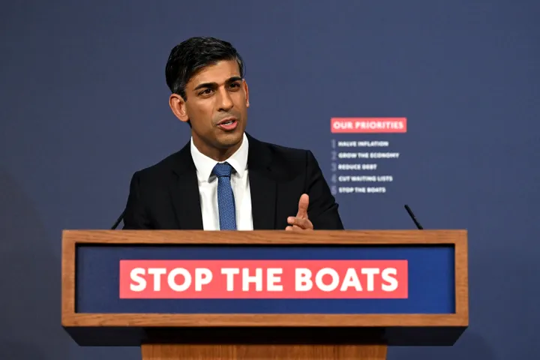
Political context
The UK Government continues to push
through hostile, harmful legislation and
measures.
These anti-refugee measures include:
‘New Plan for Immigration’ policy statement (2021)
UK-Rwanda deal (2022)
Nationality and Borders Act (April 2022)
Illegal Migration Bill (March 2023)

Slide 7
New Plan for Immigration:
Policy statement of changes to legal process & access to justice
‘One stop’ single assessment for asylum claims
All issues to be brought together at the start of the process ahead of any appeal, including modern slavery claim.
Limited appeal and Judicial Review rights
New fast-track appeal process will cover “manifestly unfounded” cases, new claims made late, and late referrals of modern slavery that seek to prevent removal.
Changes to the persecution test
Clearer and higher standard for testing a “well-founded fear of persecution”.
Credibility
Stronger questions on credibility according to journey taken and, after a refusal, failure to leave the UK.
Limits on witnesses
“Expert witnesses” to be pre-approved by Government

Slide 8
Inadmissibility rules
New ‘inadmissibility’ rules and guidance came into force at the end of 2020:
UK refusing to ‘admit’ claims on the basis of a person’s earlier presence in or connection to a safe third country
Permit removal to any safe third country that will take them.
15,898 notices of intent issued
51% have received a decision
of which 99% were admitted into the UK asylum system.
Included (=reinforced) in the Nationality and Borders Act
Notes:
https://www.refugeecouncil.org.uk/information/refugee-asylum-facts/top-10-facts-about-refugees-and-people-seeking-asylum/?doing_wp_cron=1645700070.4896318912506103515625
https://www.gov.uk/government/publications/inadmissibility-third-country-cases

Slide 9
The Nationality and Borders Act
Became law on 28 April 2022
Implemented in stages, with many key elements coming into force on 28 June

Slide 10
Nationality and Borders Act
Criminalising people for arriving without permission
Inadmissibility: Refusing to admit a person's claim if they passed through a ‘safe country’; permitting removal to any safe third country
Offshoring policies - Rwanda
One-stop process for claims and changes to persecution test
Notes:
New ‘inadmissibility’ rules and guidance came into force at the end of 2020:
On the basis of a person’s earlier presence in or connection to a safe third country, even if that particular country will not immediately agree to the person’s return.
Permit removal to any safe third country that will take them.
Included (=reinforced) in the Nationality and Borders Act
1 January 2021 - 30 June 2022:
15,898 people were issued with ‘notices of intent’
51% have received a decision
of which 99% were subsequently admitted into the UK asylum system.

Slide 11
Two-Tier System
Through ‘differentiated treatment’ the Government will put people into two categories after they receive status:
Group 1 refugees who have arrived in the UK ‘directly’ from where their life or freedom was threatened AND present themselves to the Home Office without delay.
Group 2 refugees who did not travel to the UK ‘directly’ or did not make their asylum claim as soon as
reasonably practicable

Slide 12
People who have been put in ‘Group 2’ and who receive a positive decision will get temporary refugee protection status:
Group 1 refugees | Group 2 refugees
Initial period of five years’ permission to stay | Initial period of 30 months’ permission to stay
Can apply for settlement after five years if still need protection; no requirement to demonstrate knowledge of language and life in the UK | Can apply for settlement after ten years under the long residence rules
Recourse to public funds granted | Recourse to public funds granted
Full access to the family reunion route for their family members | Access to the family reunion route for their family members where there are insurmountable obstacles to continuing family life without family reunification
Notes:
Impact of Living with NRPF: How do I survive now? The impact of living with No Recourse to Public Funds - Citizens Advice
10 Year Route: https://www.jcwi.org.uk/we-are-here-routes-to-regularisation-for-the-uks-undocumented-population
Impact on Young People: https://www.reuk.org/news-npi
Family reunion: https://familiestogether.uk/wp-content/uploads/2020/02/Without_my_family_report.pdf

Slide 13
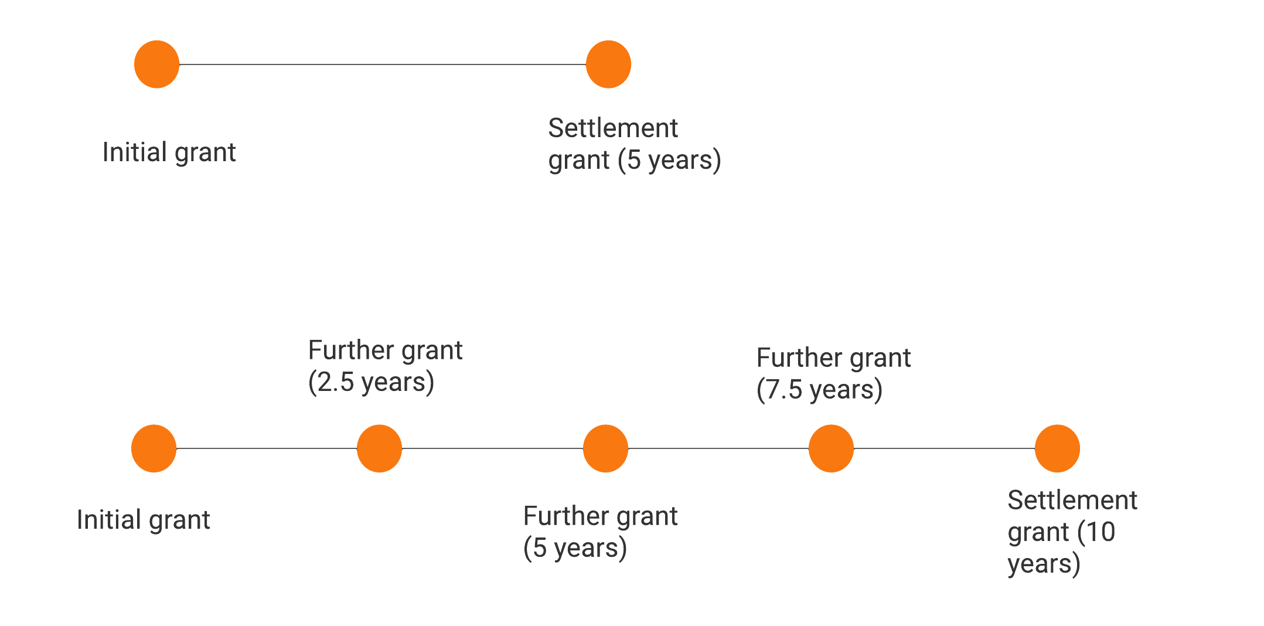
Group 2 refugees: Temporary refugee protection status
Group 1 refugees/ pre- NBA claims
Group 2 refugees under new system
Notes:
https://www.gov.uk/government/publications/considering-asylum-claims-and-assessing-credibility-instruction
https://freemovement.org.uk/differential-treatment-of-refugees-policy-guidance-temporary-refugee-permission/

Slide 14
Differentiation: impact in communities
Temporary refugee protection status will make it harder for people to rebuild their lives.
Impact of 30 months’ initial leave on opportunities to work and study;
Potential increase in homelessness and destitution;
Impact of limited family reunion rights;
Impact of uncertainty on mental and physical health.

Slide 15
Who does this apply to?
New applications made on or after 28th June 2022
Decisions on appeals considered after 28th June 2022 (to be confirmed, not clear from guidance)
Fresh claims made after 28th June 2022
Notes:
https://freemovement.org.uk/new-statement-of-changes-to-the-immigration-rules-hc-17-borders-act/
https://www.gov.uk/government/publications/permission-to-stay-on-a-protection-route-caseworker-guidance

Slide 16
UK-Rwanda Deal
Scheme to forcibly remove people who have come to the UK seeking safety to Rwanda, with no return to the UK.
Who could be affected?
An asylum claimant may be eligible for removal to Rwanda if their claim is inadmissible and:
(a) that claimant’s journey to the UK can be described as having been dangerous and (b) was made on or after 1 January 2022.
Men and women; not unaccompanied Asylum-Seeking Children
Notes:
https://www.gov.uk/government/publications/memorandum-of-understanding-mou-between-the-uk-and-rwanda/memorandum-of-understanding-between-the-government-of-the-united-kingdom-of-great-britain-and-northern-ireland-and-the-government-of-the-republic-of-r
https://reliefweb.int/report/united-kingdom-great-britain-and-northern-ireland/uk-rwanda-agreement-represents-another-blow
https://www.hrw.org/news/2022/04/14/uk-plan-ship-asylum-seekers-rwanda-cruelty-itself
https://www.gov.uk/government/publications/inadmissibility-third-country-cases/inadmissibility-safe-third-country-cases-accessible

Slide 17
UK-Rwanda Deal
Medical Justice report September 2022: ‘Who’s Paying the Price?’
Extremely vulnerable people being targeted
Severe impact on their health and wellbeing
Vulnerable people languishing in immigration detention
Profound harm caused by being held in immigration detention and by the prospect of being removed to Rwanda
Notes:
https://www.gov.uk/government/publications/memorandum-of-understanding-mou-between-the-uk-and-rwanda/memorandum-of-understanding-between-the-government-of-the-united-kingdom-of-great-britain-and-northern-ireland-and-the-government-of-the-republic-of-r
https://reliefweb.int/report/united-kingdom-great-britain-and-northern-ireland/uk-rwanda-agreement-represents-another-blow
https://www.hrw.org/news/2022/04/14/uk-plan-ship-asylum-seekers-rwanda-cruelty-itself

Slide 18
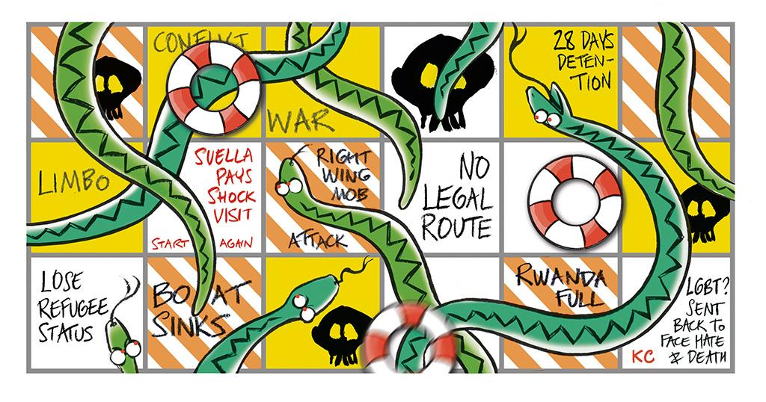
Illegal Migration Bill
“With these anti-refugee laws, the Government is closing their eyes and throwing people back to war and persecution.” Kidist, Leeds.
Introduced March 2023
Report stage and third
reading upcoming

Slide 19
Illegal Migration Bill:
destroying the right to seek safety
The Government will detain and attempt to deport people simply for seeking safety, effectively creating a ban on seeking asylum in the UK.
The bill places a new duty on the Home Secretary to take steps to remove anyone (and their family members) who fulfils the following four conditions:
○ They entered the UK in breach of immigration rules;
○ They arrived on or after 7 March 2023;
○ They didn’t travel directly from the country they’re seeking protection from;
○ They require leave to remain in the UK but don’t have it.
This would affect the vast majority of people coming to the UK to seek safety.
Notes:
https://www.refugeecouncil.org.uk/wp-content/uploads/2023/03/Refugee-Council-Asylum-Bill-impact-assessement.pdf

Slide 20
Illegal Migration Act:
destroying the right to seek safety
Any claim for protection from someone who meets the four conditions will be permanently inadmissible, including those made by both accompanied and separated children.
There will be a lifetime ban on immigration status or British citizenship, including for UK-born children
Notes:
https://researchbriefings.files.parliament.uk/documents/CBP-9747/CBP-9747.pdf

Slide 21
Illegal Migration Act:
huge expansion of detention
The bill contains extensive powers to detain people, allowing the detention of families with children and pregnant women
no time limits applying
people unable to apply to the courts for bail within the first 28 days.
Duty to remove people
Back to a ‘safe’ home country
To a ‘safe’ third country - only agreement is with Rwanda
This will leave tens of thousands of people in permanent limbo
Notes:
https://www.refugeecouncil.org.uk/wp-content/uploads/2023/03/Refugee-Council-Asylum-Bill-impact-assessement.pdf

Slide 22
Illegal Migration Act
Removal of right to appeal to Immigration Tribunal;
Removing Modern Slavery protections
Creates a cap on number of people who can arrive through ‘safe and legal’ routes
Home Secretary is not able to say that the provisions in the Bill are compatible with domestic and international human rights law
The UNHCR has warned the bill could create a ‘domino effect’ and lead to the collapse of the international system of protection for refugees
Notes:
On the basis of a person’s earlier presence in or connection to a safe third country, even if that particular country will not immediately agree to the person’s return.
Permit removal to any safe third country that will take them.
Included (=reinforced) in the Nationality and Borders Act
1 January 2021 - 30 June 2022:
15,898 people were issued with ‘notices of intent’
51% have received a decision
of which 99% were subsequently admitted into the UK asylum system.

Slide 23
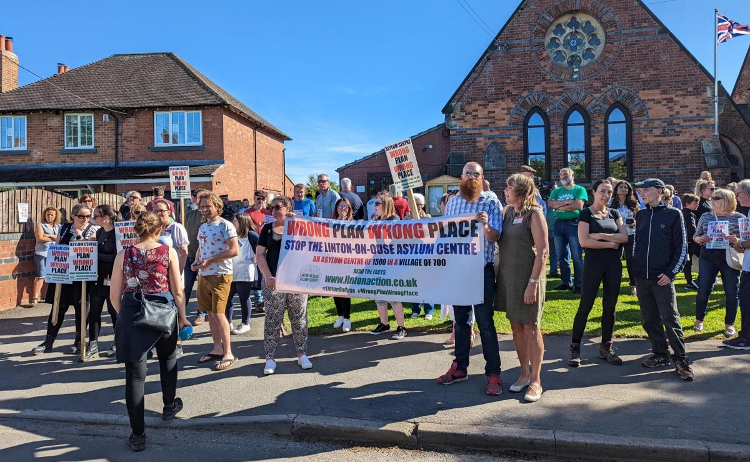
Warehousing people
Plans to warehouse people seeking asylum in harmful ex-military bases, including RAF Scampton in Lincolnshire, MDP Wethersfield in Essex, HMP Northeye in Bexhill, East Sussex, and Catterick Garrison, North Yorkshire
Also expanding use of disused ferries or cruise ships
These facilities will segregate and
re-traumatise people
no consideration of the needs of
people seeking asylum or local
communities.
Notes:
On the basis of a person’s earlier presence in or connection to a safe third country, even if that particular country will not immediately agree to the person’s return.
Permit removal to any safe third country that will take them.
Included (=reinforced) in the Nationality and Borders Act
1 January 2021 - 30 June 2022:
15,898 people were issued with ‘notices of intent’
51% have received a decision
of which 99% were subsequently admitted into the UK asylum system.

Slide 24
Campaigning for change

Slide 25
Campaigning against the bill
There are lots of resources out there!
Refugee Action - Email Your MP action
AIUK – Email your MP
Detention Action – Email your MP
Freedom from Torture - petition
Praxis - petition
Safe Passage – Email Your MP
Notes:
The anti-refugee laws are putting the right to seek safety under threat.

Slide 26
Fight the Anti-Refugee Laws Pledge
Notes:
The anti-refugee laws are putting the right to seek safety under threat.

Slide 27
Building a movement to fight the Anti-Refugee Laws!
Learn more about the pledge and add your group
Sign the #AntiRefugeeLaws Pledge as an individual
Call on your MP to sign the pledge
fighttheantirefugeelaws.org

Slide 28
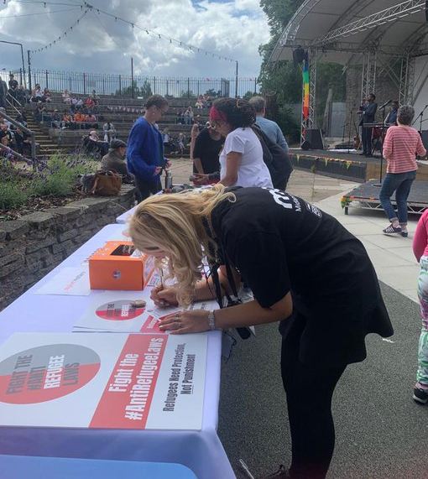
Building a movement to fight the Anti-Refugee Laws!
Spread the word and share Fight the #AntiRefugeeLaws resources on social media.
Use our Fight the #AntiRefugeeLaws resources at events

Slide 29
New resources: call on your Council to Fight the Anti Refugee Laws
Work with a local Councillor and pass a motion to:
sign the Fight the #AntiRefugeeLaws pledge
call on the Government to scrap the Illegal Migration Bill and repeal the Nationality and Borders Act
work with local groups and people with lived experience to mitigate the impact of the anti-refugee laws
commit to becoming a Council of Sanctuary
Notes:
Local Authorities have a vital role to play in opposing these cruel laws

Slide 31
Communities not Camps!
Learning and sharing tactics from Linton-on-Ouse and other sites, where local campaigns have succeeded
Supporting local campaigners at new sites
Building public campaign against the centres: we need #CommunitiesNotCamps!
Building parliamentary opposition: write to MP letter
Notes:
HO factsheet: https://homeofficemedia.blog.gov.uk/2022/04/14/factsheet-linton-asylum-accommodation/
https://www.thefieldsassociation.org/the-asylum-centre-proposal

Slide 32
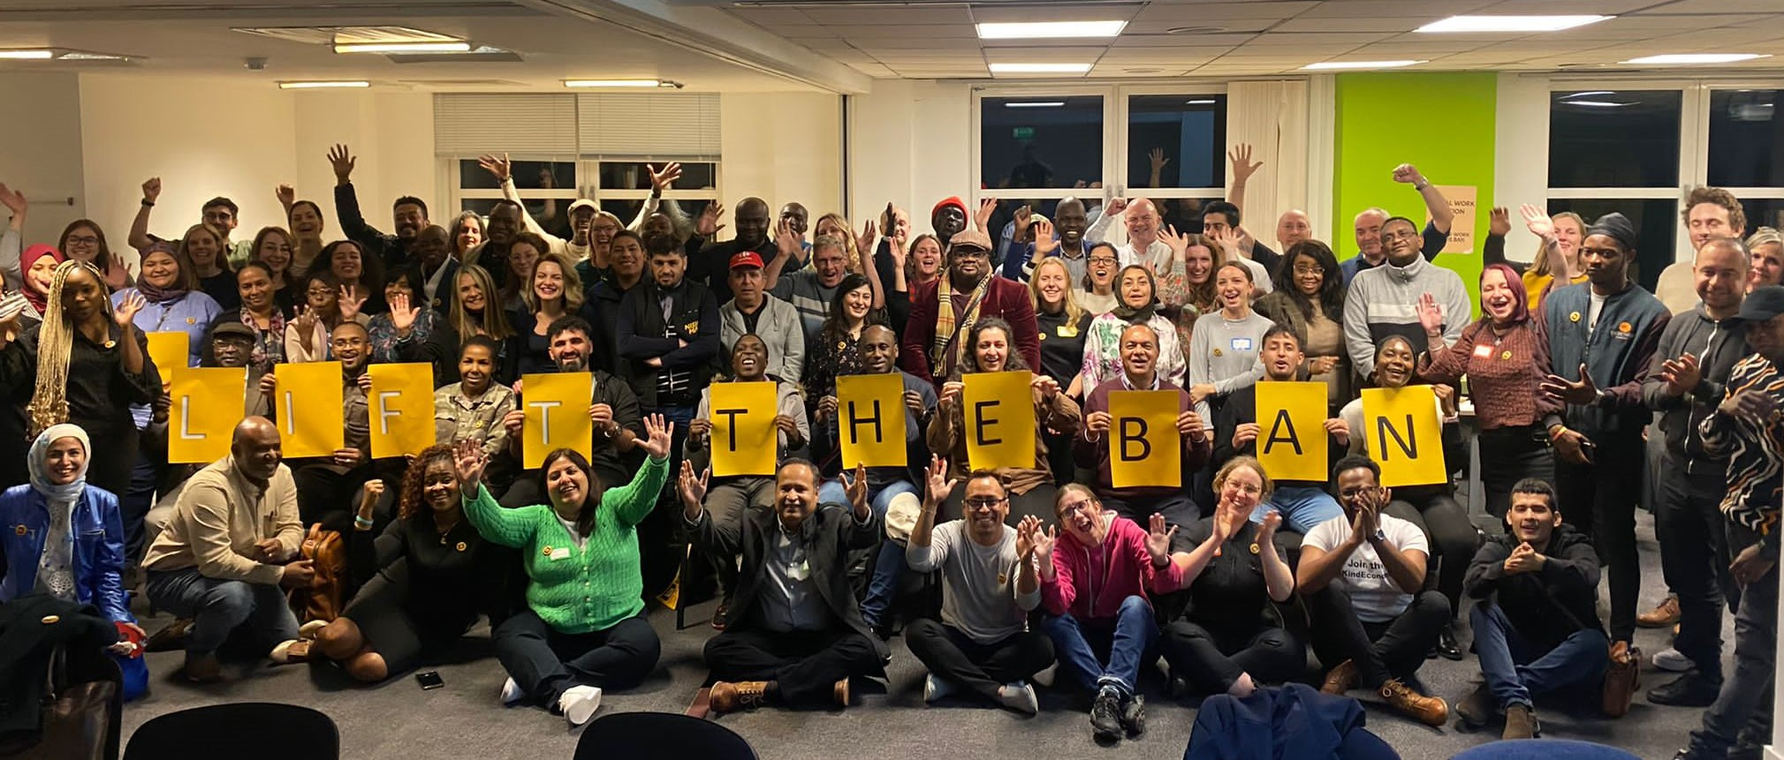
Lift the Ban
Campaigning for the Right to Work!

Slide 33
A coalition of 300+ charities, unions, faith groups and businesses
Campaigning for the right to work after 6 months of waiting
People should be able to work in any role, not just jobs on the Shortage Occupation List
Notes:
Paul introduces

Slide 34
Notes:
Paul introduces

Slide 35
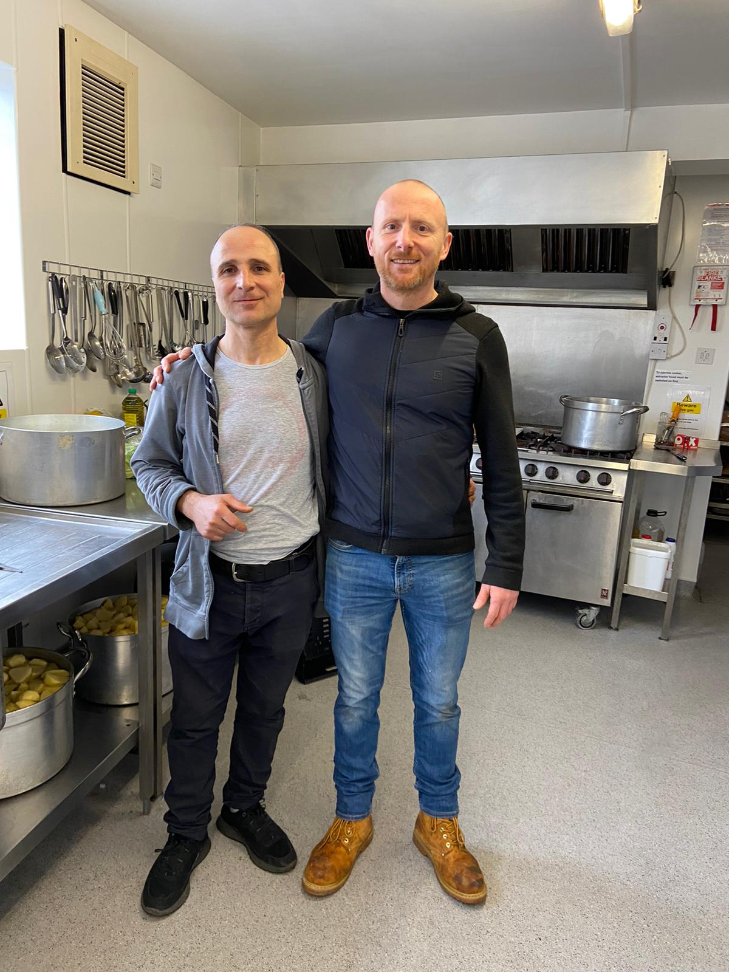
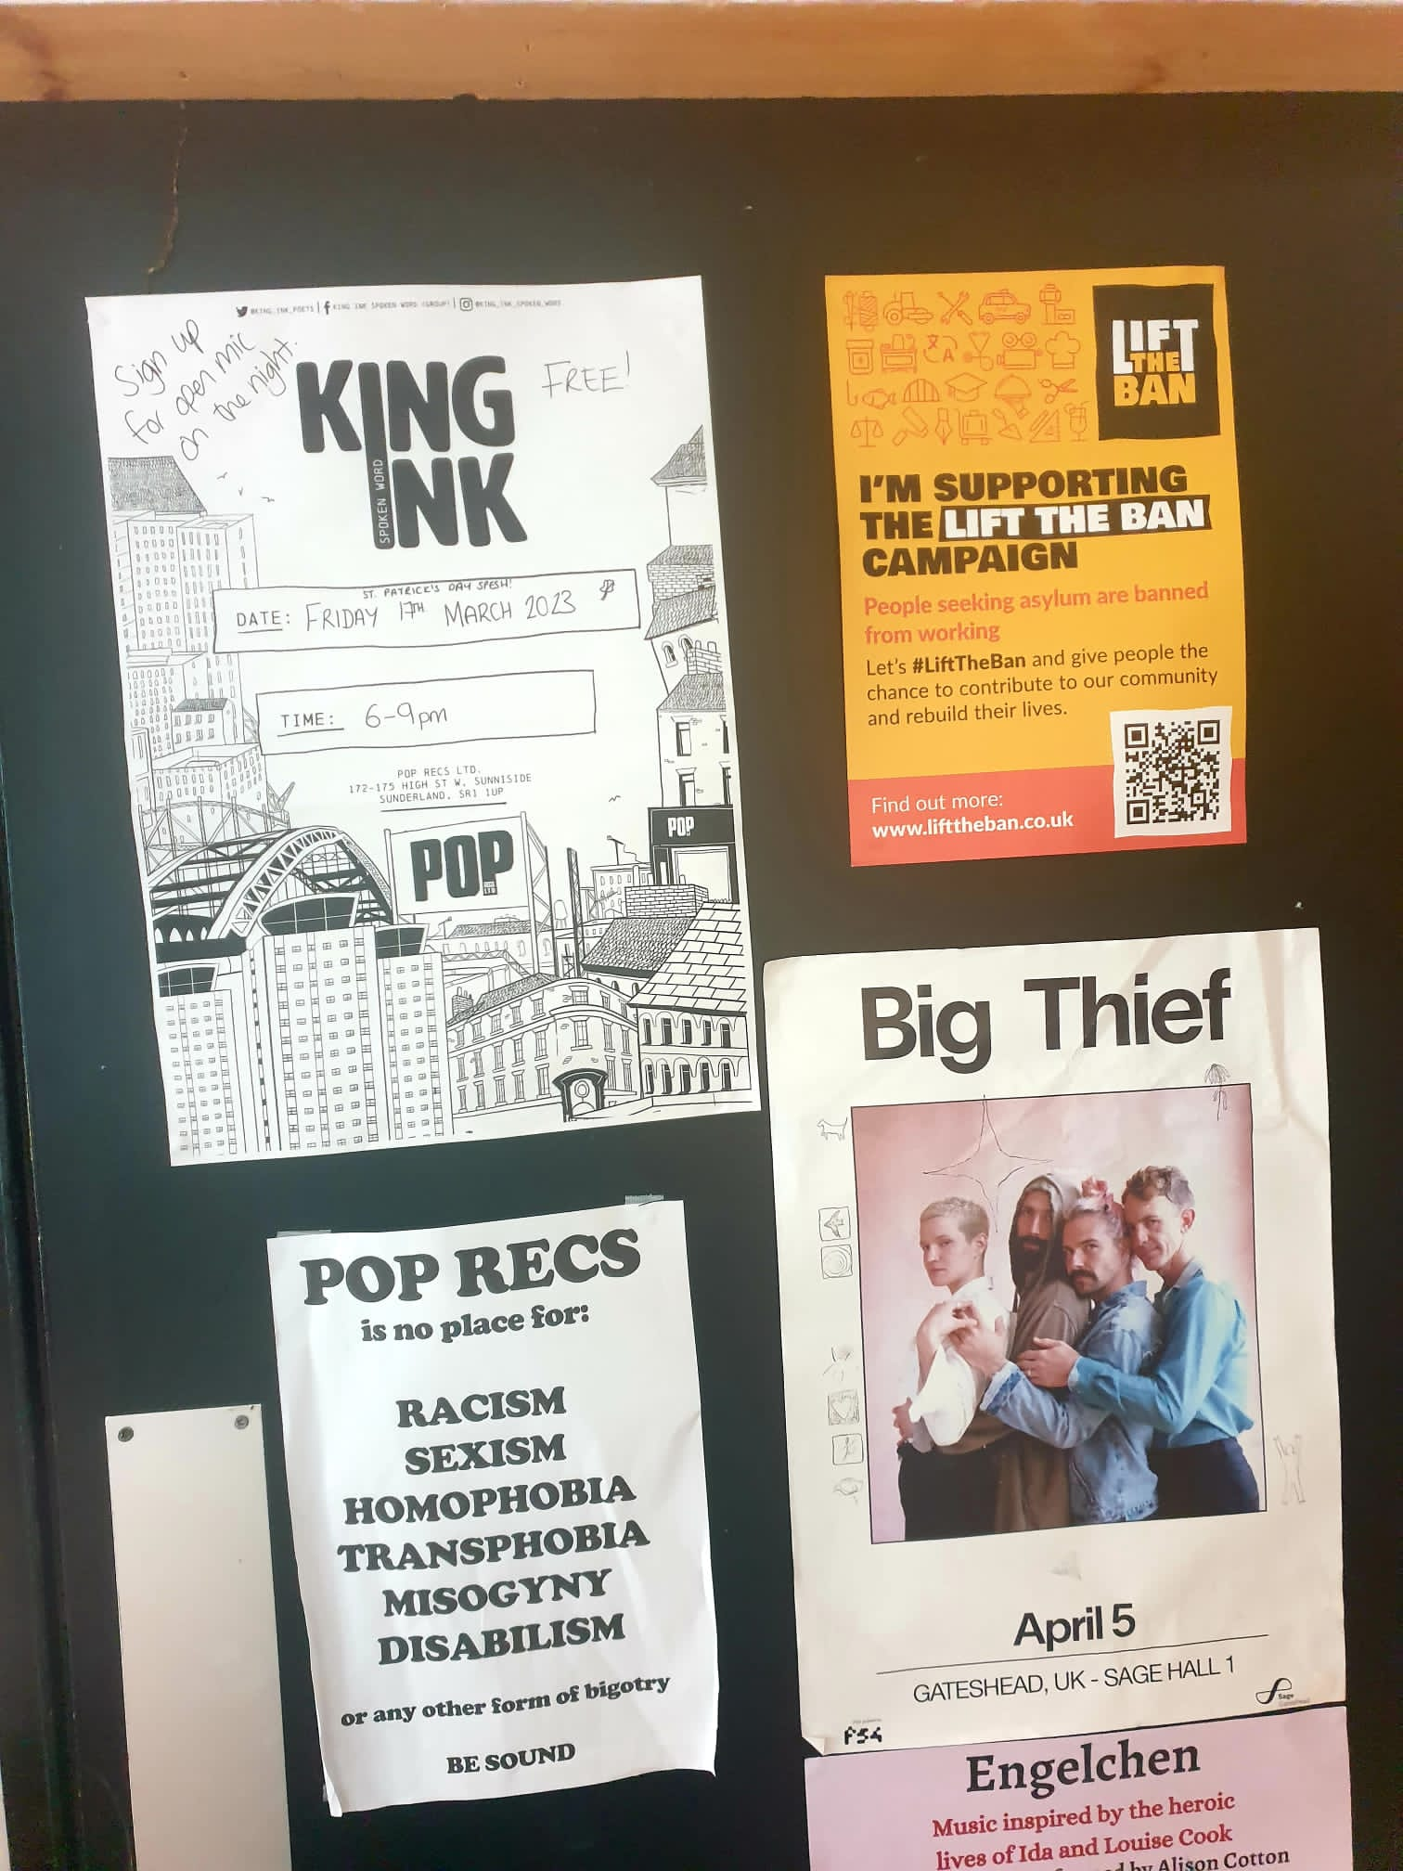
What is the High Street Challenge?
We’re calling on local businesses to support the campaign!

Slide 36
Keep in touch!
Email: mary@asylummatters.org
Website
www.asylummatters.org
Twitter
@AsylumMatters

