Slide 1
Economic stagnation in the UK: causes and consequences
Malcolm Sawyer
m.c.sawyer@lubs.leeds.ac.uk
Café Economique Leeds
6th February 2024

Slide 2
Introduction
Claim and counter-claim over growth rate generally on a short term basis, month to month, quarter to quarter; at least in media and political discussion though occasional mention of no growth in living standards over a decade or more.
First part here is to look at trends in growth, and also at what is meant by growth
Second part some underlying causes of the observed slow down in growth
Third part offers three talking points loosely related to first parts.

Slide 3
Introduction
Source of data and some reading are given at the end of the powerpoint, which is available through the Cafe Economique website

Slide 4
Growth of what?
Growth of what? GDP (Gross domestic product) which is a measure of output of goods and services produced for market;
Income (wages, profits etc)
Expenditure
Not a reliable measure of economic and social well-being (e.g. Externalities, costs, waste)
Measures only part of the economy largely that associated with markets

Slide 5
Trends
Aim to give brief overview of trends of growth of GDP for UK since circa 1970/1980 with a comparison with other G7 countires. Others are available!

Slide 6
Five year annual trend growth of GDP (%):UK 1948-2017: trend over period starting at year indicated

Slide 7
Ten year annual trend growth of GDP (%):UK 1948-2012: trend over period starting at year indicated

Slide 8
Five year annual trend growth of GDP per capita (%):UK 1948-2017: trend over period starting at year indicated

Slide 9
Ten year annual trend growth of GDP per capita (%):UK 1948-2012: trend over period starting at year indicated

Slide 10
Annual growth rate (%) of output per hour worked: average over five year period starting at year indicated

Slide 11
Gross capital formation/GDP (%)

Slide 12
Unemployment rate 1992-2023

Slide 13
Employment rates (%) 1992-2023

Slide 14
Real earnings UK 2000Q1-2023Q3

Slide 15
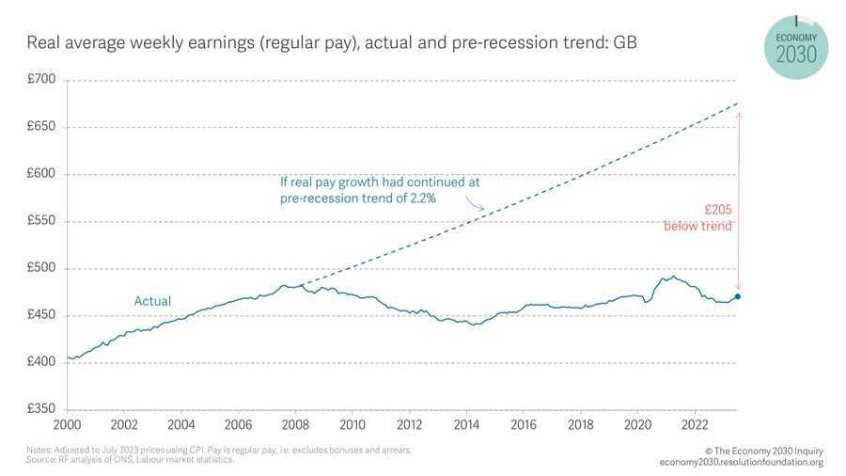
Real average weekly earnings: GB

Slide 16
Gini coefficient (measure of inequality)

Slide 17
Measures of inequality based on equivalised household income (i.e. adjusted for household size)
S80/S20: share of richest 20 per cent to share of poorest 20 per cent
P90/P10: ratio of household edge of top 10 per cent to household edge of bottom 10 per cent

Slide 18
Share of top 1 cent in income

Slide 21
Poverty
Poverty: below 60 per cent of equivalised household income after housing costs; deep poverty less than 50 per cent; very deep poverty 40 per cent.
Source: Joseph Rowntree Foundation: UK Poverty 2024: the essential guide to understanding poverty in the UK

Slide 22
Five year trend growth (annual %) G7 countries: 1960-2017

Slide 23
Five year trend growth (annual %) 1981-2017

Slide 24
Whathappened to economic well-being?
Compare GDP with two measures of economic well-being UK 1995 to 2017
benefits and costs experienced which includes consumption, unpaid work, adjustment for inequality, measures of ecological costs
benefits and costs of present economic activities

Slide 25
Panel 1: euros per person (2010 prices)
Panel 2: scaled 2007 =100

Slide 26
Whatever happened to economic well-being?
benefits and costs experienced (ISEWBCE): ISEWBCE = UW+Ci +S+Gc–DIREp–INQ–NEC (1)
benefits and costs of present economic activities (ISEWBCPA) = UW+Ci +S+Gc–DIREp–INQ–BEC+ΔK (2)
UW = unpaid work,
Ci = individual consumption,
S = shadow economy,
Gc = non-defensive collective government consumption,
DIREp = defensive, intermediate and rehabilitative private expenditures,
INQ = welfare losses from income inequality,
NEC = narrow ecological costs that are experienced in the present and within domestic borders,
BEC = broad ecological costs, including current costs within domestic borders and the costs shifted in time and space,
ΔK = capital adjustment.
UW, Ci, S, Gc are valued positively; INQ, DIREp, NEC and BEC are deducted, whereas ΔK can be either positive or negative. The ISEWs differ because they are based on two distinct welfare interpretations

Slide 27
Whatever happened to economic well-being?
ΔK = capital adjustment.
UW, Ci, S, Gc are valued positively; INQ, DIREp, NEC and BEC are deducted, whereas ΔK can be either positive or negative. The ISEWs differ because they are based on two distinct welfare interpretations
Source: Jonas Van der Slycken, Brent Bleys, “Is Europe faring well with growth? Evidence from a welfare comparison in the EU-15 (1995–2018)”, Ecological Economics 217 (2024) 108054

Slide 28
GDP as misleading indicator of well-being
GDP is a measure of market output. It takes no account of useful activities taken outside of the market (e.g. within household, within community groups). It treats expenditures such as travel to work as beneficial rather than cost of work. It treats expenditure as leading to consumer benefit rather than waste. And it makes no allowance for externalities e.g. pollution and their effects.

Slide 29
GDP as misleading indicator of well-being
The social cost of carbon dioxide (SC-CO2) measures the monetized value of the damages to society caused by an incremental metric tonne of CO2 emissions and is a key metric informing climate policy. Preferred mean SC-CO2 estimate is $185 per tonne of CO2 ($44–$413 per tCO2: 5%–95% range, 2020 US dollars).
Kevin Rennert and many others (2022), “Comprehensive evidence implies a higher social cost of CO2” Nature, vol. 610 October 2022

Slide 30
The wrong kind of slow growth?
Advocates of slow/de-growth argue that sustainability, living within planetary boundaries requires de-growth (or at least a different type of growth)
Has the slow growth of the past decade plus been environmentally friendly?

Slide 31
The wrong kind of slow growth?
Decoupling rates (ie, year-on-year percentage reduction rates in CO2 emissions per unit of gross domestic product: for UK around 5 per cent per annum
UK, as many high-income countries achieved absolute decoupling over period 2013-2020, but the achieved emission reductions are far from the emission reductions required to comply with their 1·5°C fair-shares
“Is green growth happening? An empirical analysis of achieved versus Paris-compliant CO₂–GDP decoupling in high-income countries” Jefim Vogel, Jason Hickel Lancet Planet Health 2023; 7: e759–69

Slide 32
Two frustrations
When I hear politicians and others bemoan low UK growth (of GDP) and seek to promote faster growth in the future: two frustrations
1. Why do they think that faster growth of GDP will bring gains to economic and social well-being, and why do they think it would be environmentally sustainable?

Slide 33
Two frustrations
2. There is little thought to why UK GDP growth has been lower than hitherto (though occasional mention of low investment –but why is investment low?, austerity and Brexit). And thereby what would be appropriate for raising GDP growth if that is desired. I’d prefer focus on sustainable development of economic well-being.

Slide 34
Long waves
The idea of long wages (formerly known as Kondratiev cycles)

Slide 35
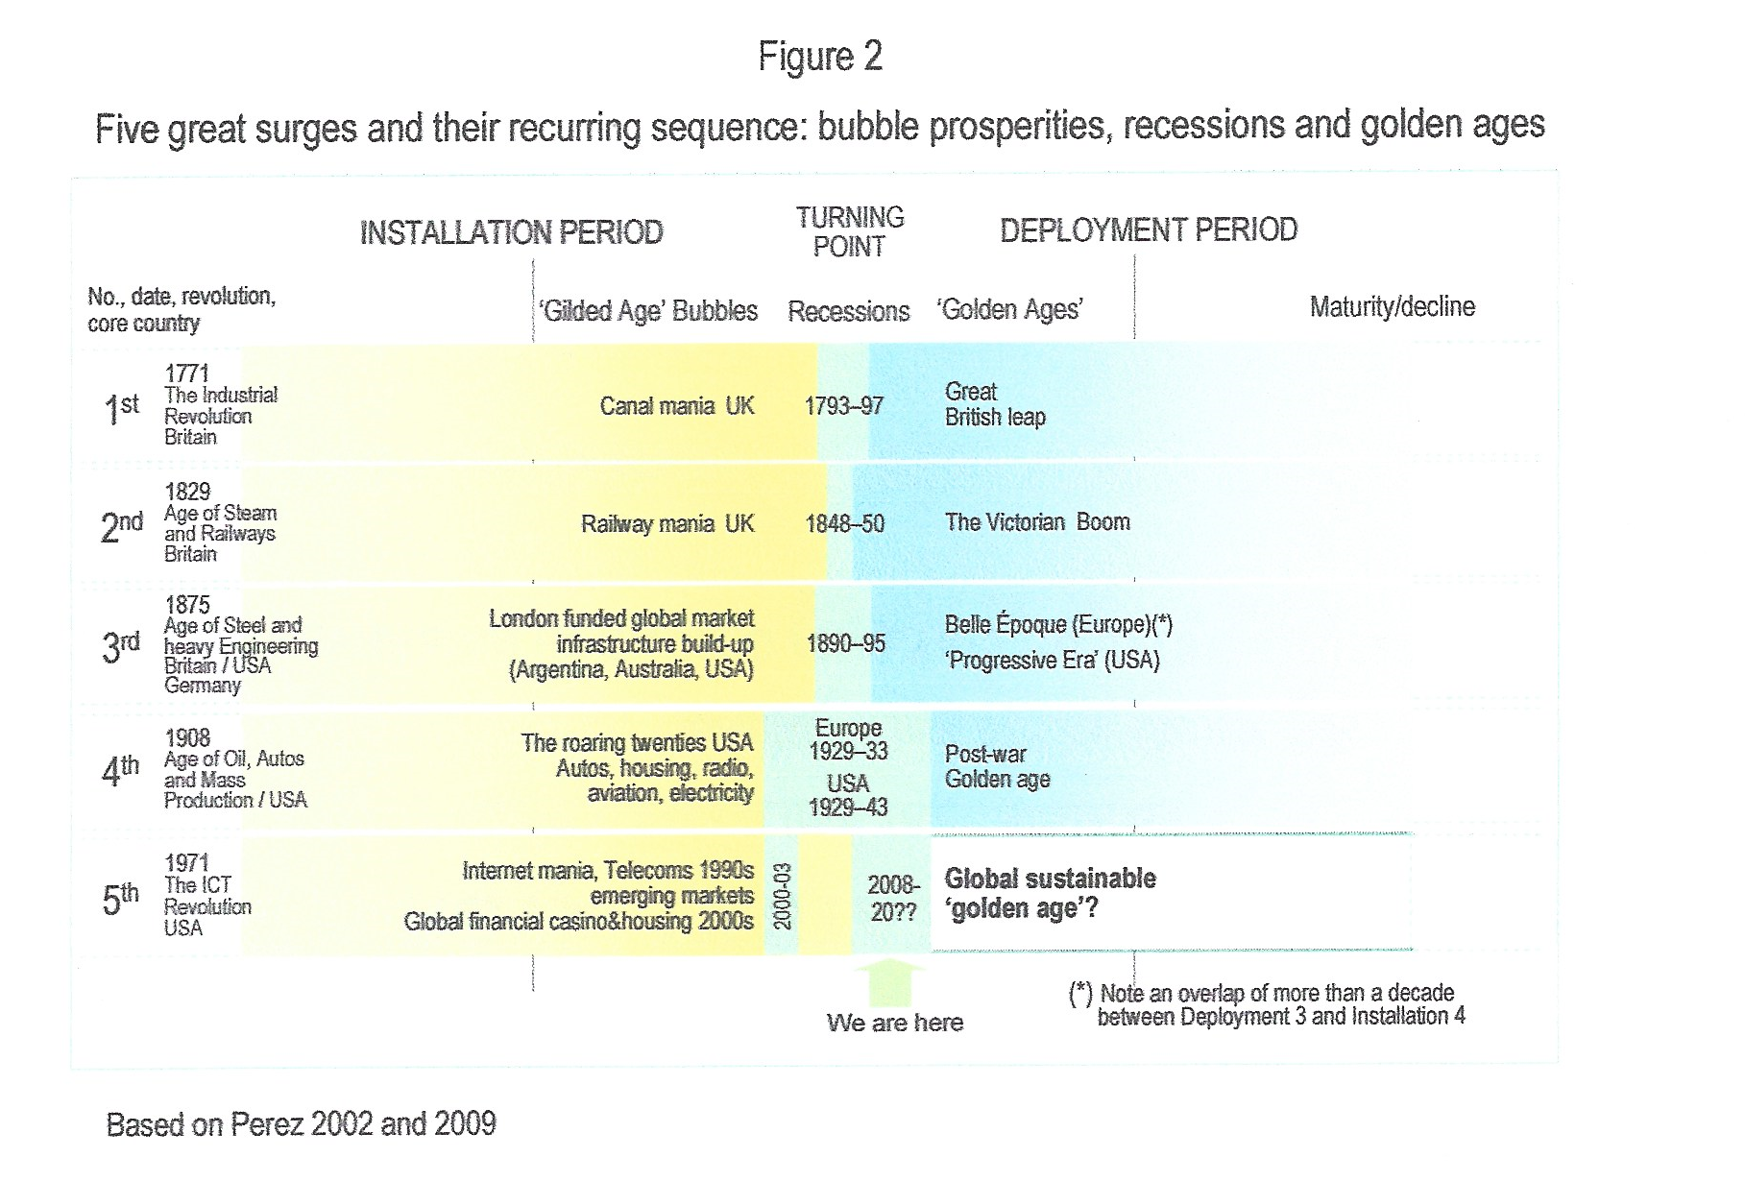

Slide 36
Secular stagnation
The issue of secular stagnation has been approached from two very different perspectives. One (which I’m not going to discuss but mention here for completeness) is that there is some combination of lower propensity to investment and higher propensity to save which have to be balanced by a zero or lower rate of interest which cannot be attained).

Slide 37
Secular stagnation
The avenue which I’ll sketch here is that the slow-down in GDP growth etc comes from the actions, decisions and behaviour of large companies which may slow down investment and research and development, which moulds the directions in which the economy travels and which tends to favour profits over wages.
Ideas along these lines were discussed in the late 1940s/early 1950s against the background of the inter-war depressions. Industries becoming more concentrated, more market power which enabled firms to raise profit margins at the expense of wages. The drive to invest and to innovate may slacken.

Slide 38
Secular stagnation
In my approach here I broaden the picture, and make reference to major shifts in the way economies operate, the economic institutions under which we live.
Before doing that I make brief mention of austerity and of the financial crises of 2007/09

Slide 39
Austerity, financial crisis and climate change
Austerity (‘fiscal consolidation’) had depressing effect on economic activity particularly in the public sector. Estimates of output lower by 1 per cent.
Financial crises of 2007/09
Climate change having effects on productivity

Slide 40
Pursuit of shareholder value
The ‘pursuit of shareholder value’ is the promotion of the view that profits and dividends (and thereby the stock market valuation of the corporation) should be or are the primary purpose of the corporation. The ‘pursuit of shareholder value’ places the shareholders (and thereby financial interests) above those of other stakeholders such as employees, customers, and the wider society.

Slide 41
Pursuit of shareholder value
The ‘pursuit of shareholder value’ pushes managers and directors of corporations to pay heed to the share price, through tying their salaries, bonuses etc to profits and the share price and more generally reviewing performance in terms of financial returns. Shareholders (most of whom are financial institutions) impose on corporations a larger distribution of profits and hence a higher dividend payment ratio, reduced internal funding for real investment.

Slide 42
Pursuit of shareholder value
The pharmaceutical industry has adopted a “highly financialized business model’ where the key measures of performance are stock price and dividend yield and distributions to shareholder through large scale stock buybacks and dividends. “With this financial behavior incentivized by stock-based executive pay, value extraction from corporations for the sake of distributions to shareholders comes at the expense of drug innovation”. Tulum and Lazonick (2018)

Slide 43
Private Equity
Private equity funds aim to take control of a business for a relatively short time, restructure it and resell the company at a profit. Restructuring can raise a number of concerns, over such things as poorer working conditions for employees and worsening services. Private equity firms may weigh down acquired companies with substantial debt from the money borrowed to finance the purchase.

Slide 44
Research and development
Research and development expenditure generally grew relatively to GDP in OECD countries including UK.
“I see computers everywhere except in the productivity figures” (Robert Solow, circa 1989)

Slide 45
Financialisation
‘”financialization means the increasing role of financial motives, financial markets, financial actors and financial institutions in the operation of the domestic and international economies’ (Epstein, 2005)
Has financialization been a drag on growth? Development of the financial sector argued to encourage savings, link savings and funding of investment and monitor lending?

Slide 46
Financialisation
Early studies tended to find that financial development and economic growth were positively related. But …
Recent studies (in effect covering experience over the past 30 to 40 years) have tended to find that past a certain size, larger financial activities either negatively or not related with growth.

Slide 47
Financialisation
Compare and contrast:
“I will unleash the economic firepower of the financial services industry to boost growth across Britain’s regions and nations.”
Rachel Reeves, X @RachelReevesMP, Jan 26 2024
“Bloated scandal-ridden finance industry is holding the UK back. Permanently mired in scandals, needs regular bailouts, provides little risk capital. Between 1995 and 2015, it made a negative contribution of £4,500bn to the UK economy. Need a public inquiry.”
Prem Sikka X @premnsikka Jan 29 2024

Slide 48
Financialisation
Report generates a comparative assessment of the costs of ‘too much finance’ for particular individual countries, arriving at a total price tag for the United States and United Kingdom from the 1990s to the current period. Their calculations suggest that the total cost of lost growth potential for the UK caused by ‘too much finance’ between 1995 and 2015 is in the region of £4,500 billion, roughly 2.5 years of the average GDP across the period.
Based on The UK’s Finance Curse? Costs and Processes. Andrew Baker, Gerald Epstein and Juan Montecino

Slide 49
Rentier income
“the term rent has been [long been] used … to refer to incomes that are analogous to land rents, in the sense that they reward control of persistently scarce or monopolised assets, rather than contribution.” (Stratford, 2022)
. Rentier income is income based on the passive ownership of financial and real assets.

Slide 50
Rentier income
“The definition of rent: income derived from the ownership, possession or control of scarce assets under conditions of limited or no competition” (Christophers, 2020).
“rent is payment to an economic actor (the rentier) who receives that rent – and this is the key factor – purely by virtue of controlling something valuable. The ‘something’, whatever it happens to be, is referred to generically as an ‘asset’: an ‘item of value owned’ (to borrow the standard dictionary definition) that is valuable precisely in view of the fact that control over it endows the owner with the capacity to generate future income.”

Slide 51
Forms of contemporary rentierism
Asset | Primary means of gaining asset control | Principal income streams
Financial | •Creation of credit money by private banks •Acquisition of financial assets in primary and secondary markets | •Interest • Dividends • Capital gains
Natural resource reserves | • Leasing agreements with mineral rights owners | • Product sales
Intellectual property | •Registration of rights (e.g. to patents, trademarks) with state intellectual property | • Product sales • Royalties

Slide 52
Forms of contemporary rentierism
Digital platforms | •Organic creation | • Commissions • Advertising fees
Service contracts | •Bidding processes (various) | • Service fees
Infrastructure | • Privatization of state-owned enterprises • Licensing by government • Organic creation | • Service fees • Licensing fees
Land | • Acquisition in markets • Privatization of public-sector landholdings | • Ground rent.
Source: Christophers (2020), Table P-1

Slide 53
Rise of monopoly power
The past decades have seen rising industrial concentration across many countries
Meagher (2020) has recently argued that “the evidence shows that competition is giving way to monopoly across the economy” (p.20). Further, she argues that “markets inexorably tend towards concentration, and we seem incapable of enforcing the restraint to prevent the accumulation of money and power.”
Davies (2021) reported the Herfindahl Hirschmann Index for producer concentration ignoring imports and exports for over 300 UK industries at the 4-digit level and found that, on average, concentration rose steadily from 1998 to 2011 and remained high thereafter (through to 2018). About 30 % of industries could be classified as ‘concentrated’ or ‘highly concentrated’

Slide 54
Three unrelated sets of concluding thoughts
Talk about development of economic and social well-being which is environmentally sustainable and within planetary boundaries, and not about ‘growing the economy’
Focus on the building blocks of development of economic well-being – develop health, education, social care as the basis of growth and not the afterthought.
Address the ‘private affluence’/’public squalor’ (mention the notion of ‘wasted GDP’)
The centrality of a broad based environmentally sustainable industrial policy and ‘green new deal’

Slide 55
Three unrelated sets of concluding thoughts
The financial sector needs re-structuring and down-sizing.
Use of financial transactions taxes
The development of public development banks
The development of mutual co-operative banks

Slide 56
Three unrelated sets of concluding thoughts
Socially responsible corporations
Mutual and co-operative organisations
Community based economic and social activities

Slide 57
Some reading
Two papers by myself
“Secular stagnation and monopoly capitalism”, Journal of Post Keynesian Economics, 46:4, 545-565, available on open access: www.tandfonline.com/doi/epdf/10.1080/01603477.2023.2270949?needAccess=true
Monopoly capitalism in the past four decades', Cambridge Journal of Economics, 46(6), 1225-1241

Slide 58
Some reading
Brett Christophers (2020), Rentier Capitalism, Who Owns the Economy, and Who Pays for It?, Verso Books
Beth Stratford (2023) Rival definitions of economic rent: historical origins and normative implications, New Political Economy, 28:3, 347-362,

Slide 59
Source of data
The graphs in this presentation are my calculations based on data from Office of National Statistics and from World Bank
Graphs from Resolution Foundation and Joseph Rowntree Foundation

