Slide 1
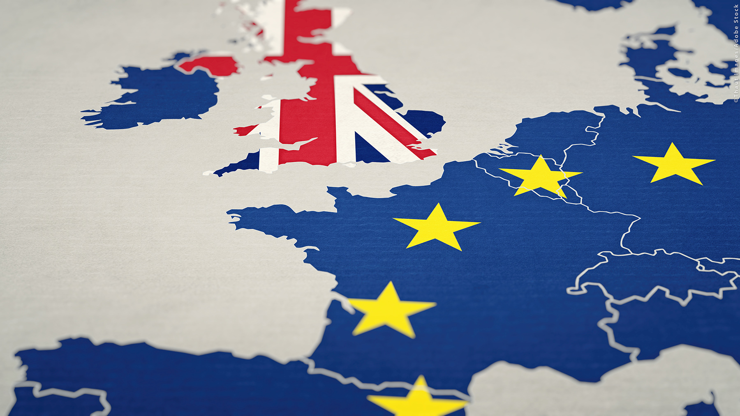
“Brexit & UK’s complicated relationship with the European Union past, present and future”
Muhammad Ali Nasir

Slide 2
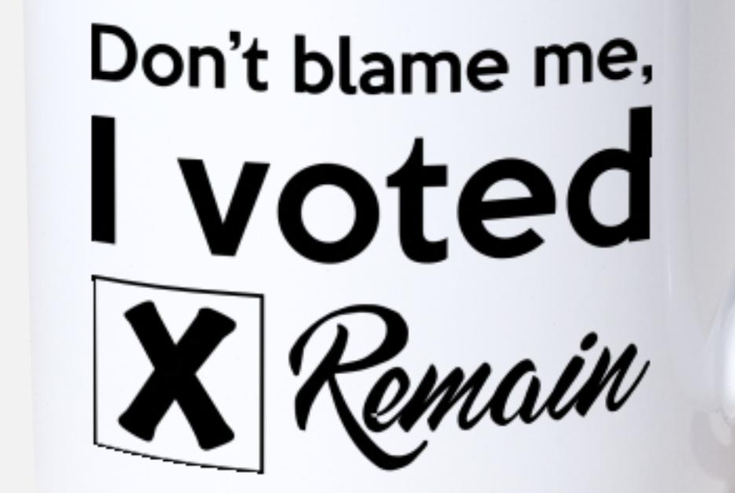
Disclaimer

Slide 3

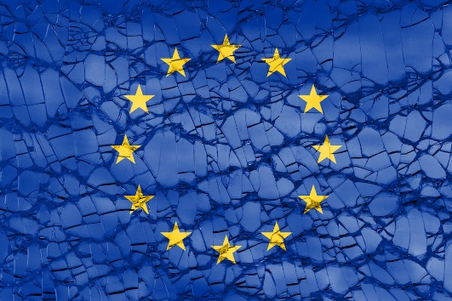
Idea of European Integration
League of Christian Nations – 1464 AD
(King George of Poděbrady to the King Louis XI)
United States of Europe & European Parliament – 1693 AD (William Penn)
European League of Sovereign States – 1658 - 1743 AD (Abbé de Saint Pierre)
Perpetual Peace – 1795 AD (Immanuel Kant)
Napoleon’s European Union: The Grand Empire of the United States of Europe (Markham; 1966)
United States of Europe Oak – 1870 : My Revenge is Fraternity! – 1849 (Victor Hugo)
The Future of Europe in Economic, Political and Social Terms - 1885 AD (Theodore de Korwin Szymanowski)
European Confederacy, Hitler said “No” ! (Lipgens,1985)
United States of Europe - 1946 (Winston Churchill)
Notes:
https://rm.coe.int/16806981f3

Slide 4

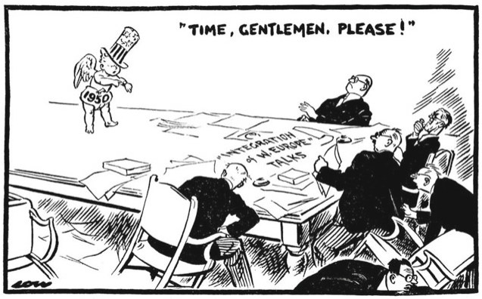
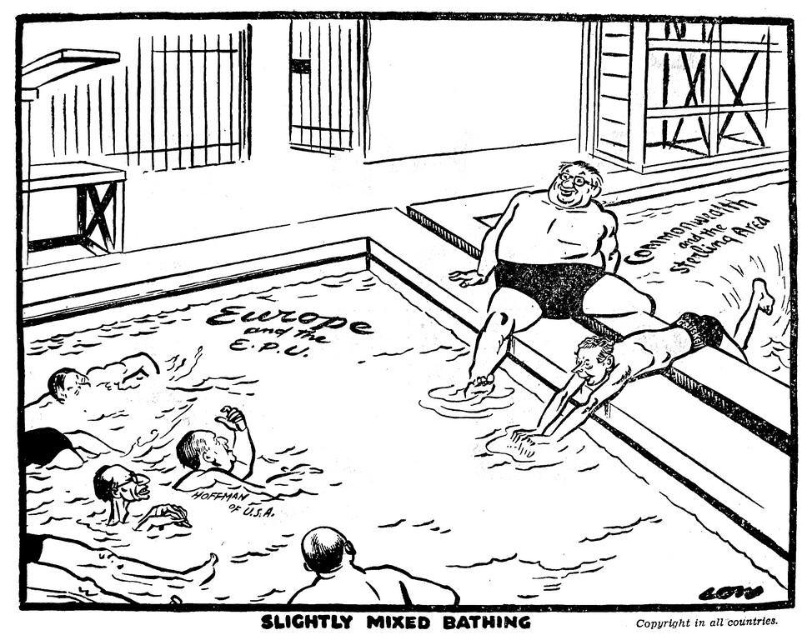
Post-WWII : Now's the Time
North Atlantic Treaty Organization (NATO) - 1949
Organisation for European Economic Co-operation (OECC - 1948) reconstituted Organisation for Economic Co-operation and Development (OECD -1960).
Council of Europe (1949) for legal and human rights aspect.
British memorandum on the future of intra-European payments – 1949
The European Payments Union (EPU) – 1950.
(Source Evening Standard.1949 “Time, Gentlemen, please!”, : David Low)
Joining the European Payments Union (EPU) (Daily Herald. 1950; Ernest Bevin, Foreign Secretary [left], and Hugh Gaitskell, Chancellor of the Exchequer [right].
Notes:
General Hastings Ismay

Slide 5
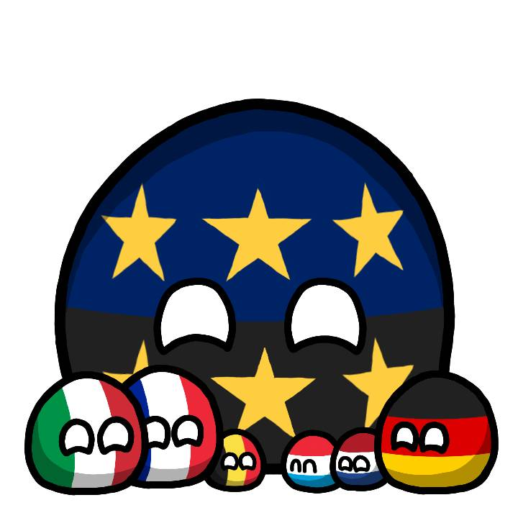
European Coal and Steel Community (ECSC)
Robert Schuman and Jean Monnet (Schuman Declaration) May 1950 & Treaty of Paris - 1951
Saarland to Western Germany
High Authority (European Commission) and the Common Assembly (European Parliament)
We will not accept the economy being “handed over to an authority that is utterly undemocratic and is responsible to nobody” (Clement Attlee)

Slide 6


European Economic Community (EEC)
Spaak Committee & Treaty of Rome in March - 1957
UK pulled out from the Spaak Committee and did not commit to the EEC.
European Free Trade Association - 1960
  (Austria, Denmark, Norway, Portugal, Sweden, Switzerland and the United Kingdom)
Charles DeGaulle's Veto on British Membership – 1963 & 1967 ("trojan horse“ of US).
1973 enlargement of the European Communities, Denmark, Ireland and the UK (Edward Heath) joined. Norwegian public opted out.
Referendum Act 1975 & European Communities membership referendum – 1975 (Harold Wilson)
Do you think that the United Kingdom should stay in the European Community (the Common Market)?
Yes | No | Invalid | Total | Turnover
67.23 % | 32.77 % | 0.22 % | 100 % | 64.62%
Notes:
Belgian Foreign/ Prime Minister Paul-Henri Spaak,
UK delegation represented by Russell Frederick Bretherton pulled out from the Spaak Committee and did not commit to the EEC.
"The Bretherton syndrome of 'Britain knows best’
The Luxembourg Compromise (January 1966) - Pierre Werner and the European integration process: from the Schuman Plan to the Fontainebleau Summit (cvce.eu)
Merger Treaty 1965-67

Slide 7
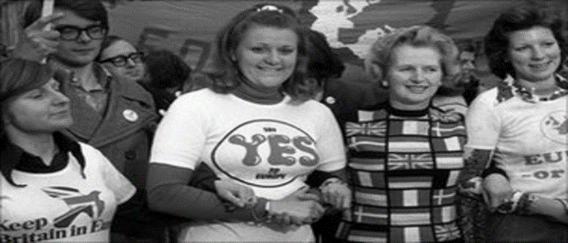
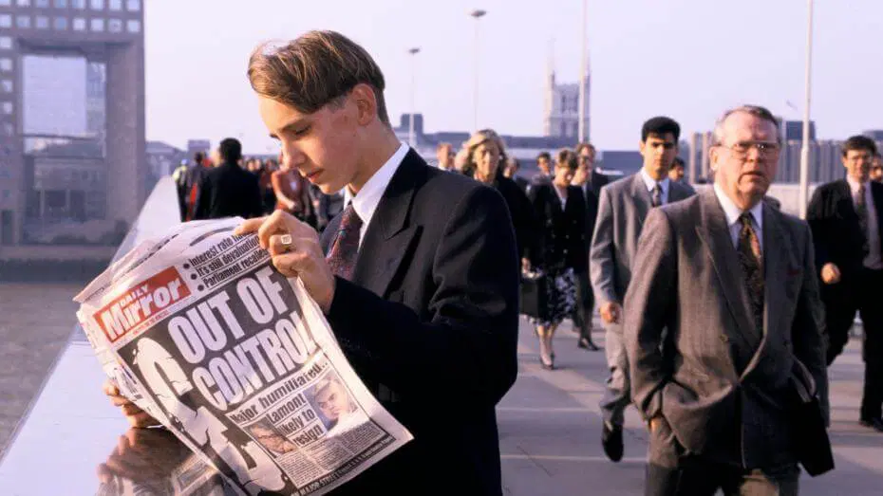
Single European Act (SEA) / European Exchange Rate Mechanism (ERM)
"I want my money back!“ (Thatcher, Nov 1979).
European Monetary System: European Exchange Rate Mechanism (ERM) - 1979 but UK joined in October 1990
Black Wednesday Sep – 1992 (£3.3 billion loss).
Single European Act (SEA - 1986) with objective of establishing a European single market by December 1992.
Notes:
As part of the EMS, the EEC established the first European Exchange Rate Mechanism (ERM) which calculated exchange rates for each currency[1] and a European Currency Unit (ECU): an accounting currency unit that was a weighted average of the currencies of the 12 participating states.[4][5] The ERM let exchange rates to fluctuate within fixed margins, allowing for some variation while limiting economic risks and maintaining liquidity.
Jacques Delors (report)
The Single European Act was the first major revision of the 1957 Treaty of Rome. The Act set the European Community an objective of establishing a single market by 31 December 1992,

Slide 8
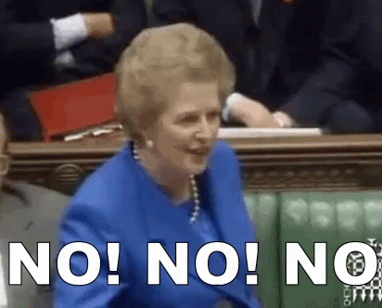
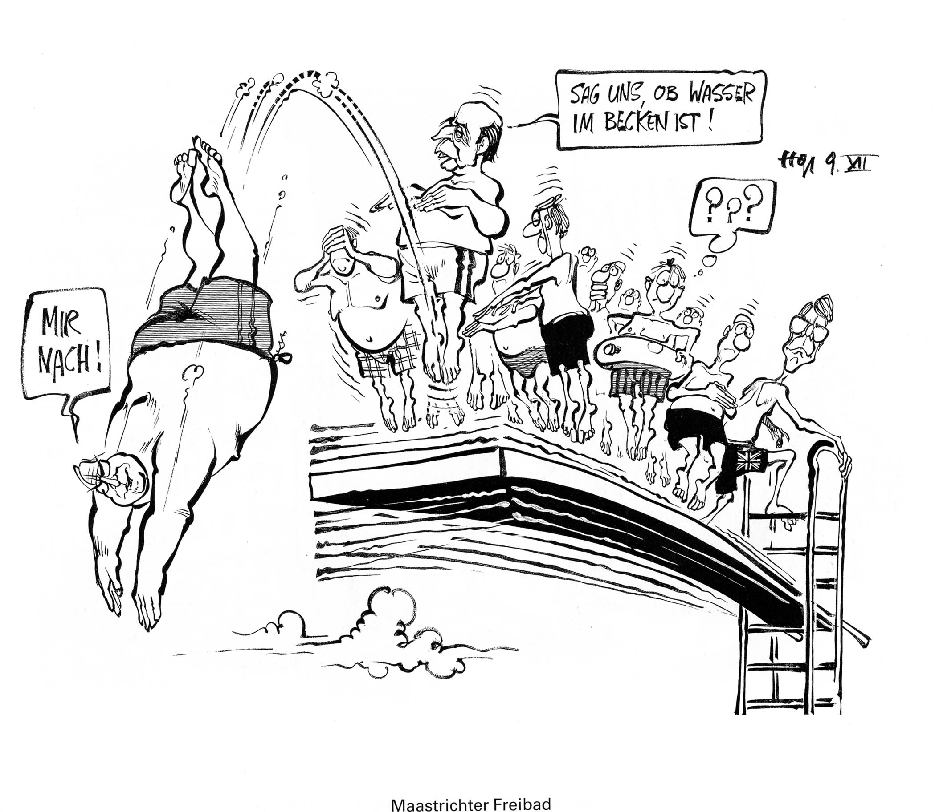
Treaty on European Union (TEU) / Maastricht Treaty
Jacques Delors Commission/Report EMU- 1989
      Not for 700 Years.
      Conveyor belt of Federalism. (Margaret Thatcher)
Treaty on European Union/ Maastricht Treaty – Feb 1992
      UK opted out Euro
Schengen Area / Schengen acquis – established 1995
      UK opted out
Charter of Fundamental Rights of the European Union
      UK opted out
Area of freedom, security and justice (home affairs)
      UK opted out
Notes:
‘Maastricht open-air swimming pool: “Follow me! Let us know if there’s any water in the pool!”’ On 9 December 1991, on the eve of the Maastricht European Council, German cartoonist Horst Haitzinger takes an ironic look at the commitment (‘Follow me!’) of German Chancellor Helmut Kohl to Economic and Monetary Union (EMU) and to the Treaty on European Union. French President François Mitterrand, second in line, seems more reluctant to take the plunge (‘Let us know if there’s any water in the pool!’), while British Prime Minister John Major seems to be about to climb down from the diving board.

Slide 9
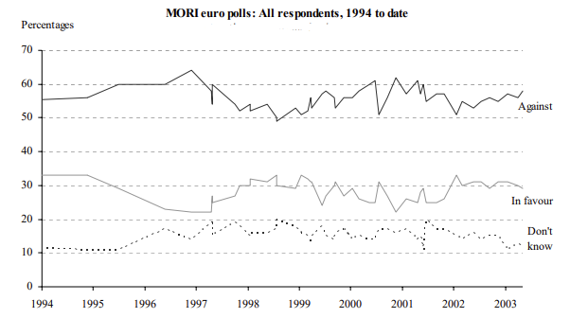
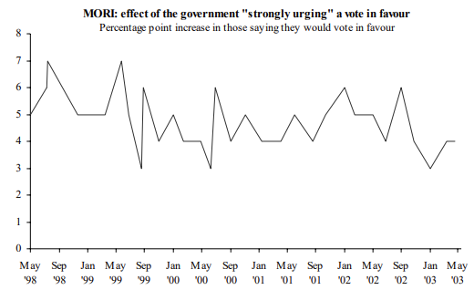
UK Membership of the Single Currency
Treasury’s assessment & Five Economic Tests – 1997 & 2003
  Are business cycles and economic structures compatible so that we and others could live comfortably with euro interest rates on a permanent basis? X
  If problems emerge is there sufficient flexibility to deal with them? X
  Would joining EMU create better conditions for firms making long-term decisions to invest in Britain? X
  What impact would entry into EMU have on the competitive position of the UK’s financial services industry, particularly the City's wholesale markets? X
  In summary, will joining EMU promote higher growth, stability and a lasting increase in jobs? X
Notes:
https://researchbriefings.files.parliament.uk/documents/RP03-53/RP03-53.pdf

Slide 10
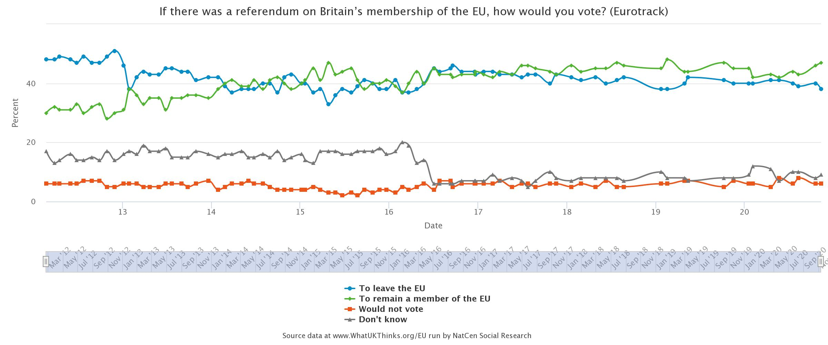
Public opinion on the membership of EU
Notes:
https://whatukthinks.org/eu/questions/if-there-was-a-referendum-on-britains-membership-of-the-eu-how-would-you-vote-2/#

Slide 11
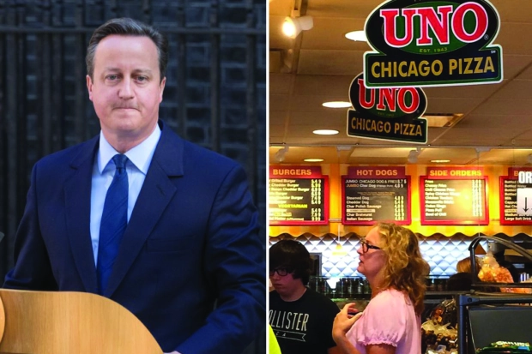
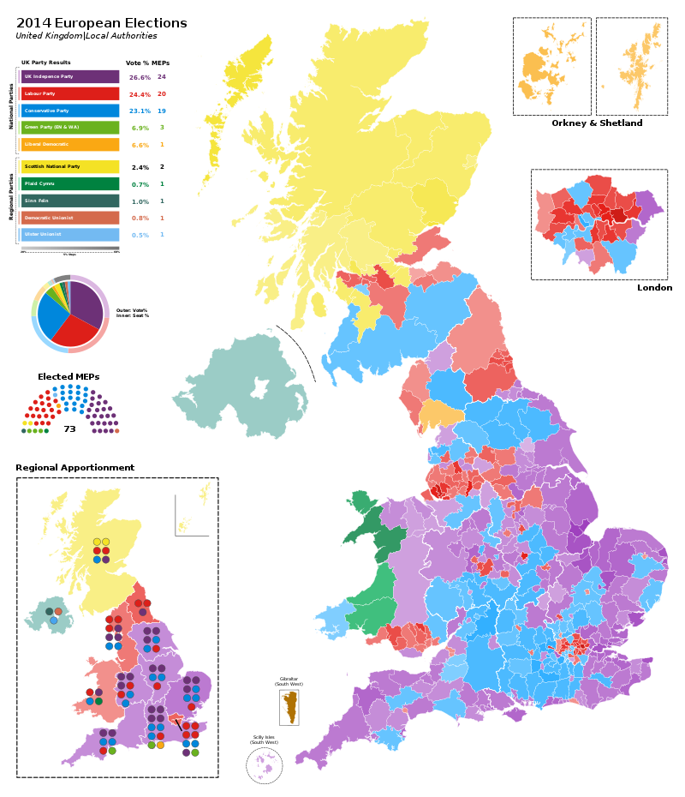
Eurosceptic & Cameron’s Charm Offensive
Pizza restaurant at Chicago O'Hare airport & Brexit – NATO 2012
EU speech at Bloomberg David Cameron promises in/out referendum – 2013
European Union (Referendum) Bill 2013 – Labour and Lib Dem abstained
European Parliament election in 2014 & UK Independence Party (UKIP)
General elections 2015 – Conservatives 330 seats
European Union Referendum Act 2015

Slide 12
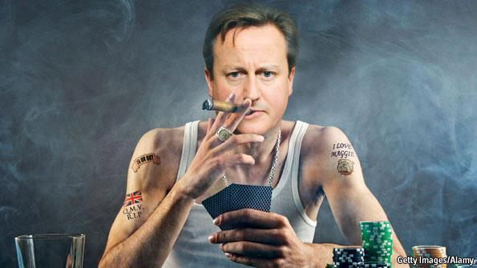
Opt-outs Not Opted – Cameron’s Deal
Pre Brexit Re-negotiations of membership : 2015 - 2016
  Emergency brake (in-work benefits)
  The "Red Card“ (block or reform EU rules)
  Deporting EU migrants ( e.g. criminal reason)
  Child benefit (country of residence)
  Ever closer union (symbolic term but)
  Protection for non-eurozone countries (No contribution to bailouts, currency, financial regulations, or decisions in favour of Eurozone)
  Limiting residence rights for family members

Slide 13
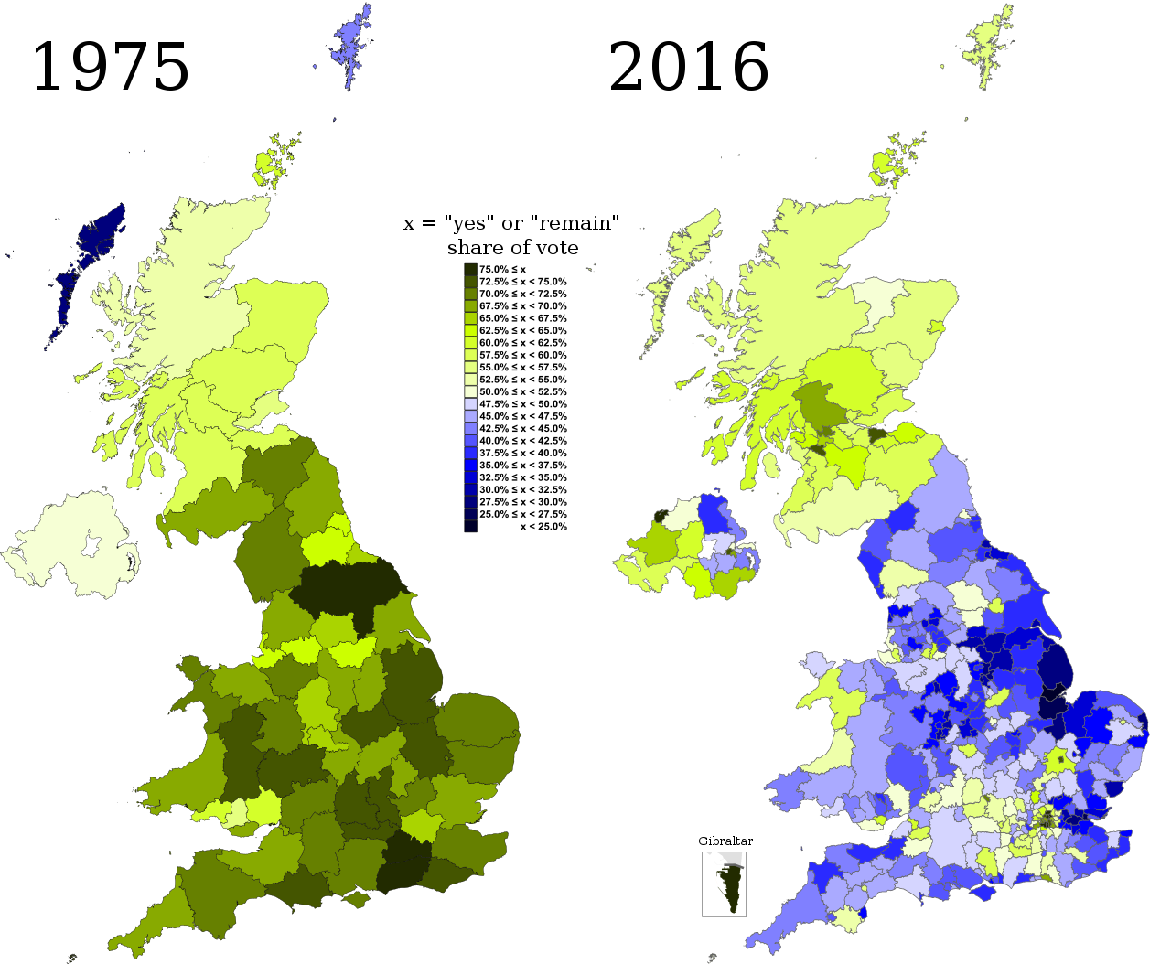
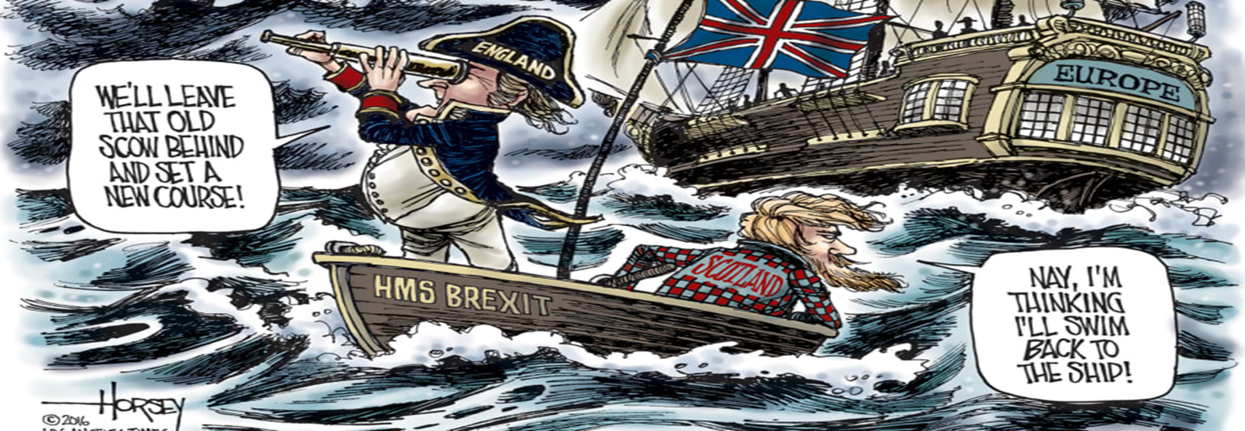
Referendum – June 2016
Q: Should the United Kingdom remain a member of the European Union or leave the European Union?
Leave | Remain | Invalid | Total | Turnover
51.89 % | 48.11 % | 0.08 % | 100 % | 72.21%

Slide 14
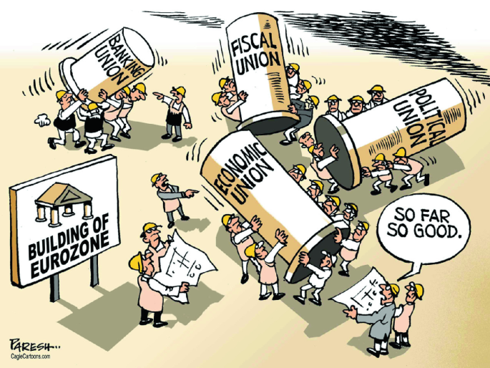
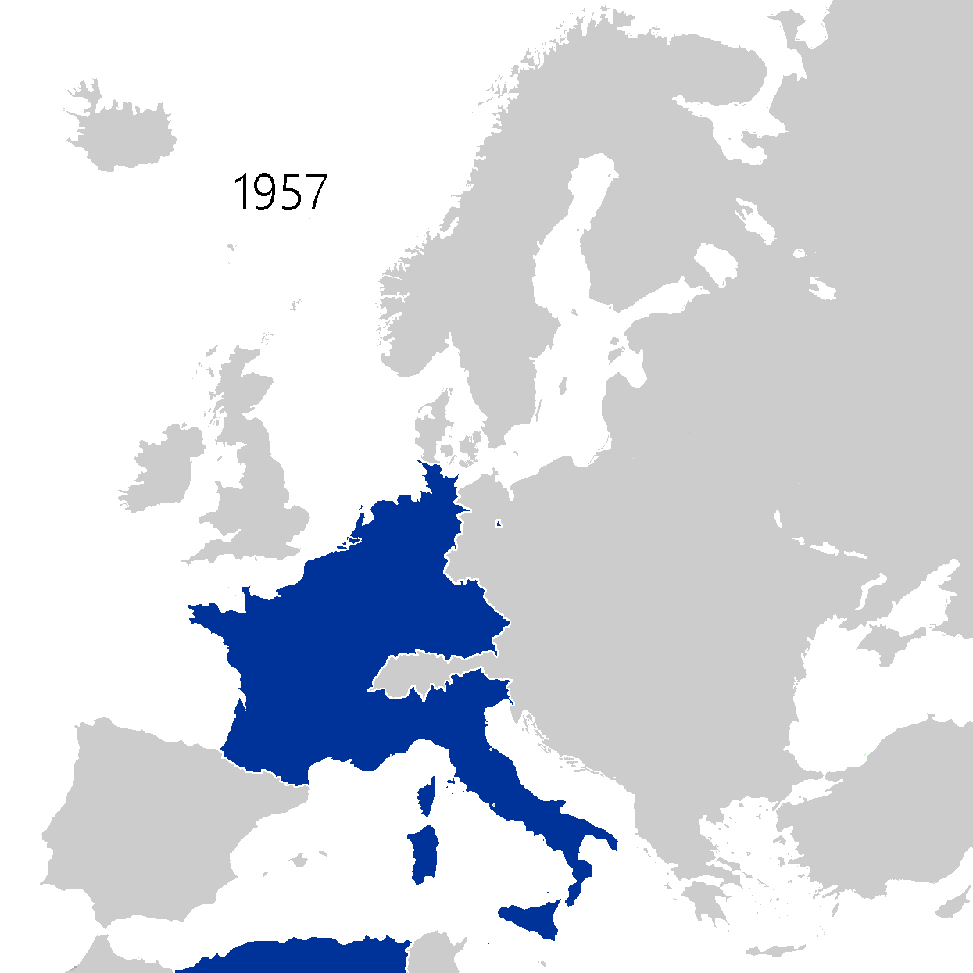
Building of Eurozone — Unions within Unions
“UK should leave the EU as the union's core members were set to bind closer together to save the euro, meaning the status quo was "not sustainable". (Gisela Stuart, 2012)

Slide 15
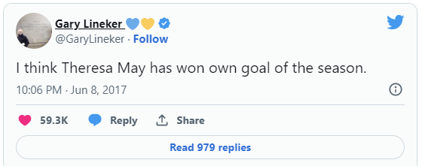
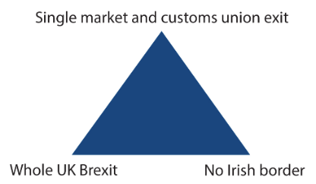
Brexit means Brexit
Strong and Stable
UK invocation of Article 50 of the TEU – March 2017. Two years for divorce settlement.
“Elections only way to guarantee certainty and security for years ahead“
  (Theresa May)
Theresa May's Brexit deals
Chequers plan – July 2018, Rejected by EU Sep 2018
Common Travel Area (CTA)- Good Friday Agreement - Irish Backstop
Brexit withdrawal agreement agreed by EU leaders Nov 2018
3 strikes (Jan – March 2019)- Brexit Postponed
Boris Johnson - July 2019
Theresa May's Irish trilemma
Notes:
https://www.cer.eu/insights/theresa-mays-irish-trilemma

Slide 16
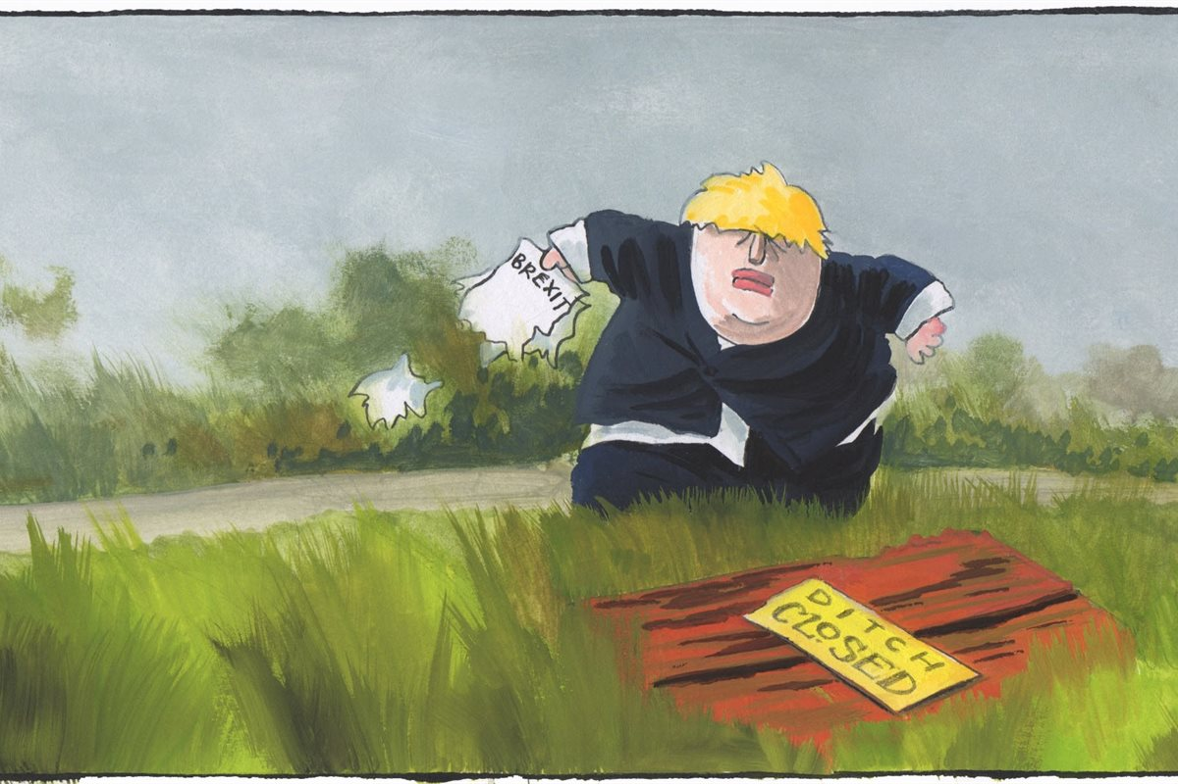
Deal or Ditch
"Time is too short to find an alternative arrangement to the Irish backstop and Britain's divorce deal with the European Union will not be re-opened for negotiation” (Michel Barnier, Jan 2019).
Boris letter to European Council President Donald Tusk (Aug 2019).
  Anti-democratic and inconsistent with the sovereignty of the UK
  Inconsistent with the UK's desired final destination
  Risks weakening the Good Friday Agreement
Merkel – Johnson – Macron (2019)
Deal or No Deal – Snap elections needed 2/3rd
Department for Exiting the EU (DExEU) : Operation Yellowhammer
Prorogation – Aug 2019
No-deal Brexit - “Exit Day" 31st October 2019
Benn Act / "Surrender Act” - Sep 2019
‘Die in a ditch’ (Sep 2019)
Notes:
On 21 August 2019, Angela Merkel offered and Boris Johnson accepted a suggestion that the British Government should come up with a viable alternative to the backstop.
Macron indicated that no deal was the most likely Brexit outcome due to the inability of the UK to accept the withdrawal agreement.
In October 2019, the new Johnson government renegotiated the draft, replacing the backstop. In the new protocol, the whole of the UK comes out of the EU Customs Union as a single customs territory. Northern Ireland will be included in any future UK trade deals, but will have no tariffs or restrictions on goods crossing the Irish border in either direction, thereby creating a de facto customs border down the Irish Sea with Great Britain. There is also a unilateral exit mechanism by which the Northern Ireland Assembly can choose to leave the protocol via a simple majority vote.

Slide 17
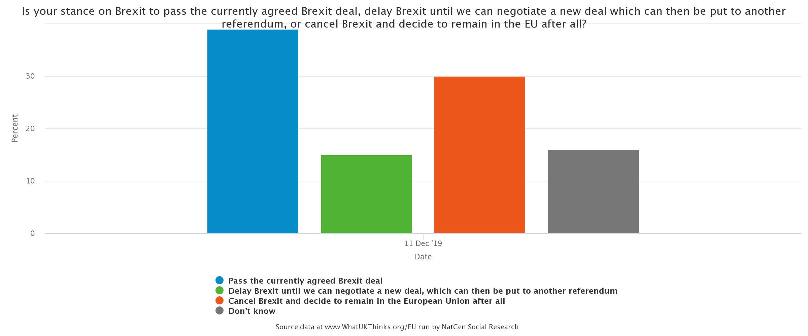
General election : Get Brexit Done
Johnson and Leo Varadkar meeting and resumption of negotiations
Brexit withdrawal Agreement - October 2019
New protocol on Northern Ireland/Republic of Ireland
Oven-ready Deal
Conservative 365 / 650 seats – Dec 2019
Elections referendum on the Deal ?
Notes:
On 28 August 2019, Johnson advised Queen Elizabeth II to prorogue Parliament from the second week of September 2019 until 14 October 2019, days before a scheduled summit of the European Council on 17 October
EU (Withdrawal) (No. 2) Act (Sep) 2019 – Benn Act / "Surrender Act“
On 19 October, Johnson sent the letter to the president of the European Council Donald Tusk requesting an extension to the Brexit withdrawal date per the Act. This was formally approved on 28 October. On 30 October 2019, the day named as "exit day" in UK legislation was accordingly changed to 31 January 2020 at 11.00 p.m

Slide 18
EU–UK Trade and Cooperation Agreement (TCA)
UK left the EU on 31st January 2020 – transition arrangement
TCA signed Dec 2020 & UK left Jan 2021
  Zero tariff zero quota
  Support trade in services
  Cooperation in Energy, Paris Agreement, but no longer EU-ETS
  European Atomic Energy Community (EAEC or Euratom)
  Intellectual property
  No free movement of persons
  Cooperation in aviation and road transport (Not member of EU Aviation Safety Agency EASA)
  Fisheries - EU fishing quotas in UK waters will gradually reduced.
  Cooperation in security/criminal data exchange, Horizon but no Erasmus.
  Institutional provisions and dispute settlement - EU–UK Partnership Council.
Notes:
The UK leaves the EU Common Fisheries Policy. During a transitional period of 5+1⁄2 years, EU fishing quotas in UK waters will gradually be reduced to 75% of their pre-Brexit extent.
In the UK-EU Trade and Cooperation Agreement (TCA), there are agreed rules on international investment and trade in services, known as core commitments. These rules allow firms from each party to sell services to, and invest in, the other party, without discrimination.

Slide 19
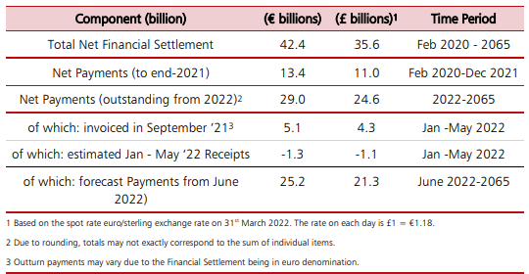
Brexit Divorce Bill
Financial Settlement
HMT’s Financial Settlement Payment Breakdown – July 2022
The Office for Budget Responsibility (OBR) estimates for 29th March 2019 £37.1 billion.
Notes:
20220720_EU_Finances_Statement_2021_with_cover_v3_FINAL.pdf (publishing.service.gov.uk)
By 31 December 2021, the UK had paid a net amount of £11 billion and was due to have paid a further net £3.3 billion to the end of May, leaving £21.3 billion outstanding, with future current payments of almost €900 million a month
In 2017, the UK had a 16% share in the European Investment Bank (EIB) worth £8.8 billion
The Bank of England (BoE) has invested in the European Central Bank (ECB) amounting to 14.3374% of its paid up capital, equating to €58.2 million at 1 January 2019.
In March 2018, the UK's Office for Budget Responsibility (OBR) published the UK's economic and fiscal outlook including details of the estimated financial settlement as at 29 March 2019, the original date that the UK was to leave the EU, which it estimated at £37.1 billion (€41.4 billion).

Slide 20
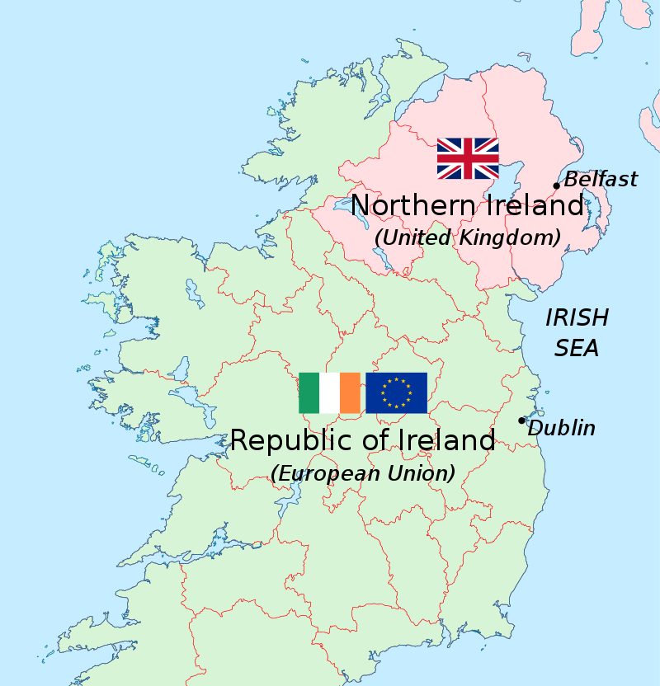
The Protocol on Ireland/Northern Ireland
Protect the EU single market & avoid Hard border
  Protocol created a de facto customs border in the Irish Sea
  Continued democratic consent in Northern Ireland – 4 years
  Good Friday Agreement and Common Travel Area respected
  NI remains part of the customs territory of the UK & part of UK future trade deals
  De jure customs border between NI and the RI, but de facto customs border in Irish Sea.
  Court of Justice of the European Union (CJEU) has jurisdiction over interpretation
  EU vaccine export controls row Jan 2021 (Article 16)
Notes:
The backstop would have required keeping Northern Ireland in some aspects of the European Single Market.
In the formally negotiated Withdrawal Agreement, the 'Irish backstop' was removed, and replaced by this new protocol. The whole of the UK would leave the EU Customs Union as a single customs territory with Northern Ireland included in any future British trade agreements, but that Northern Ireland would adopt EU Single Market regulations on goods and thus remain an entry point into the EU Customs Union.
Article 16 of the Northern Ireland Protocol part of the deal allows the EU and UK to choose to suspend any aspects they consider are causing "economic, societal or environmental difficulties".

Slide 21
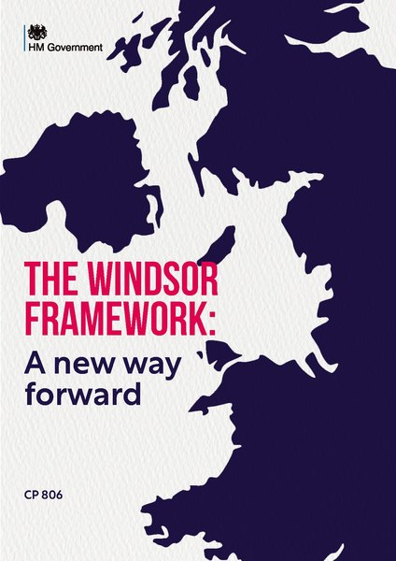
Windsor Framework
Northern Ireland Protocol Bill (Proposed June 2022)
Windsor Framework (Feb 2023)
Green and red lanes, Data sharing with EU
No infringement proceedings against the UK
"Stormont brake“ power to NI assembly
European Court of Justice (ECJ) as the final arbiter of EU law
Notes:
The Northern Ireland Protocol Bill of 2022–23 is a proposed Act of the Parliament of the United Kingdom that seeks to unilaterally override parts of the Northern Ireland Protocol (NIP).
the "Stormont brake", which would allow the Northern Ireland Assembly to temporarily stop any changes to EU goods regulations from applying in Northern Ireland if the Assembly feared that the changes would have a "significant and lasting effects on everyday lives
https://www.instituteforgovernment.org.uk/comment/windsor-framework-cooperation

Slide 22
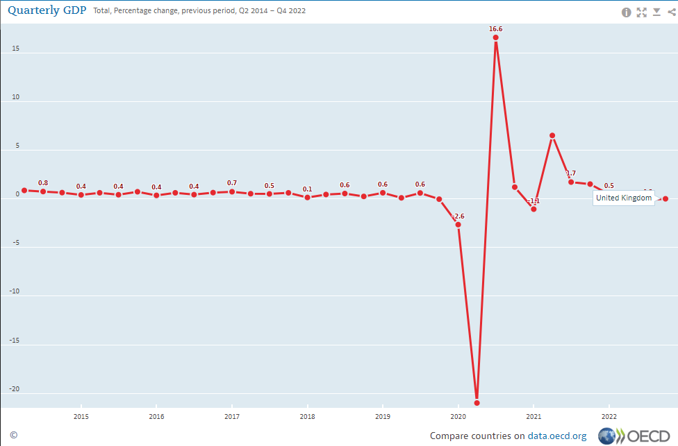
Impact of Brexit
Annual loss of GDP per household under the three alternatives after 15 years would be:
  £2,600 in the case of European Economic Area (EEA) – (Norway)
  £4,300 in the case of a negotiated bilateral agreement – (Switzerland, Turkey or Canada)
  £5,200 in the case of WTO membership - (Brazil)
Weaker tax receipts £20 - £36 - £45 billion (HMT, April 2016).
GDP would be 6% lower in next 2 years – It wasn’t (HMT, May 2016).
In the long-run productivity – 4%, exports and imports -15% (OBR Feb 2023).

Slide 23
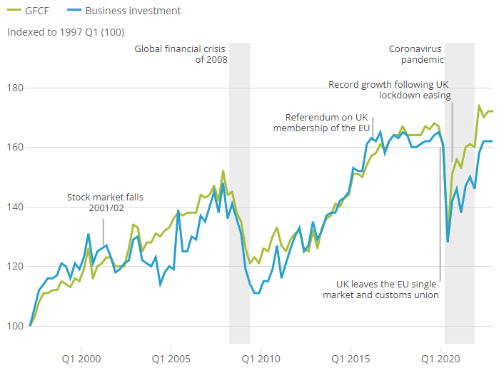
Investment in the UK
The disparity since 2020 between whole economy investment (also call gross fixed capital investment (GFCF)) and business investment remains.
1997Q1 to 2022Q4; Source (ONS)
Notes:
https://www.ons.gov.uk/economy/grossdomesticproductgdp/bulletins/businessinvestment/octobertodecemberrevisedresults

Slide 24
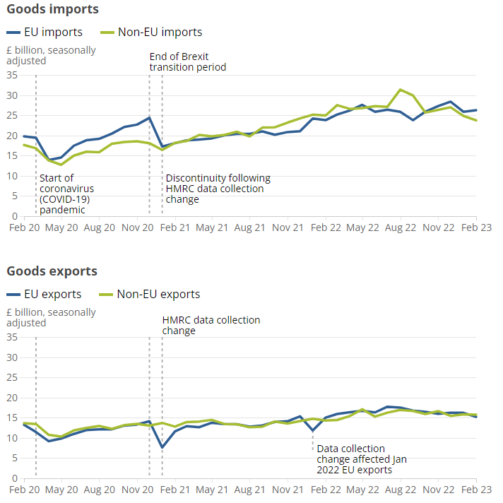
Impact of Brexit on UK Trade
EU and non-EU goods imports and exports, excluding precious metals, current prices, seasonally adjusted, February 2020 to February 2023
Source: UK trade statistics from the Office for National Statistics
Notes:
EU and non-EU goods imports and exports, excluding precious metals, current prices, seasonally adjusted, February 2020 to February 2023
https://www.ons.gov.uk/economy/nationalaccounts/balanceofpayments/bulletins/uktrade/february2023

Slide 25
When the effect of inflation is removed
Source: UK trade statistics from the Office for National Statistics
Trade has remained relatively stable over the past year

Slide 26

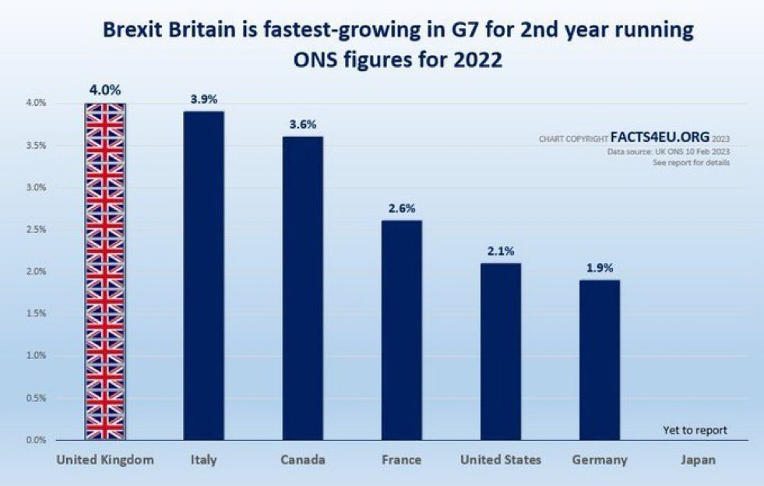
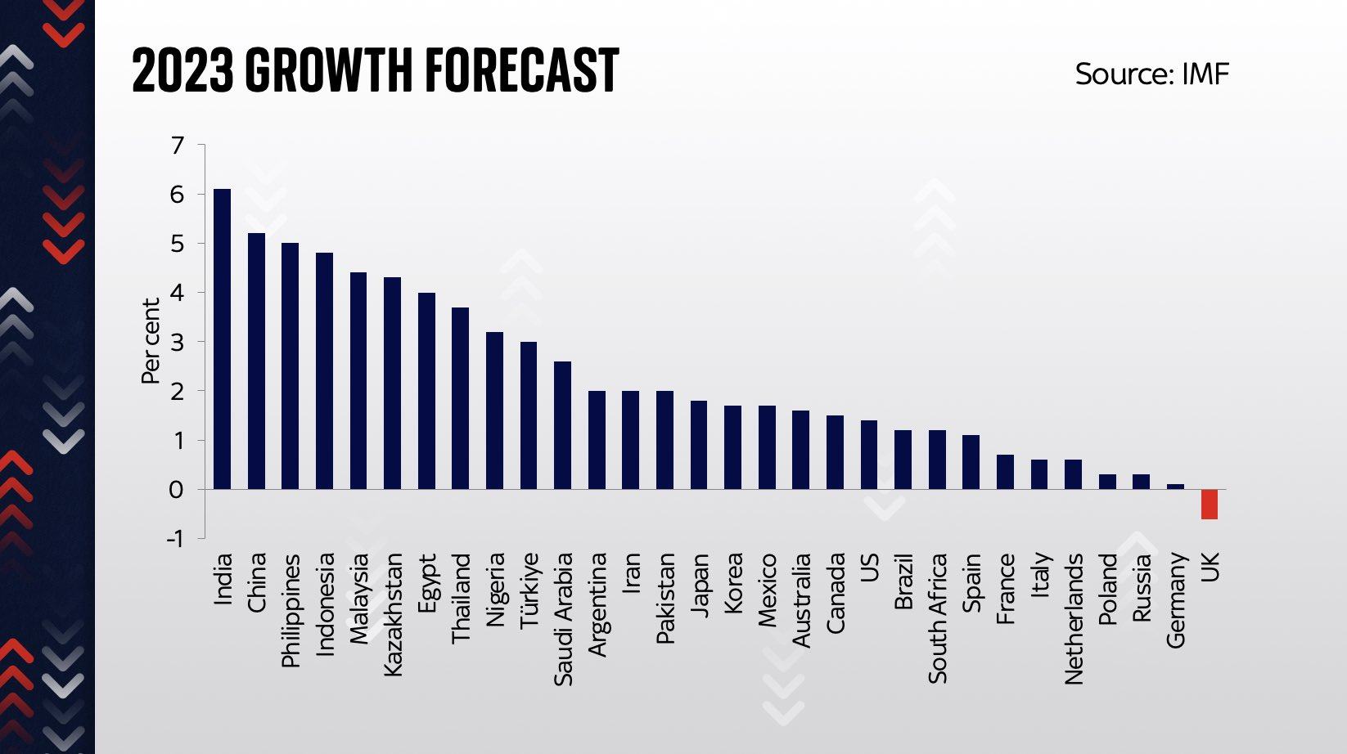
Lies, damned lies, statistics and
Revised to - 0.3% instead of -0.6% (IMF Global Economic Outlook, April 2023)

Slide 27
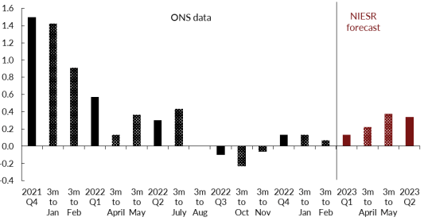
UK Economy Shows Resilience
Figure – UK GDP growth (3 months on previous 3 months, per cent), Source; NIESR (2023)
Notes:
https://www.niesr.ac.uk/wp-content/uploads/2023/04/April-GDP-Tracker-final-1.pdf

Slide 28
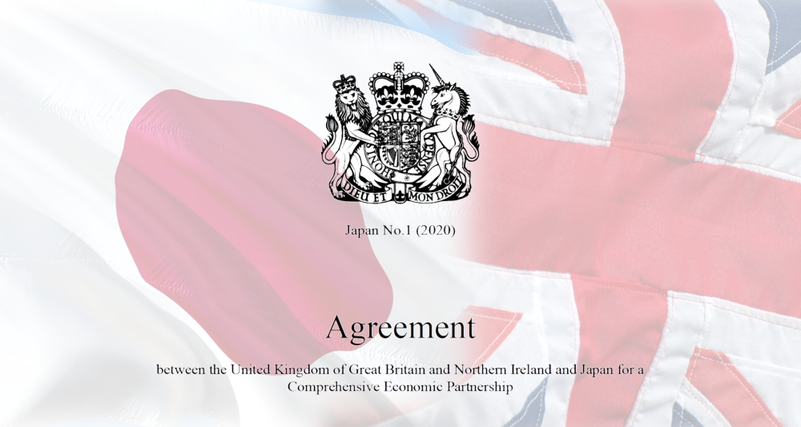
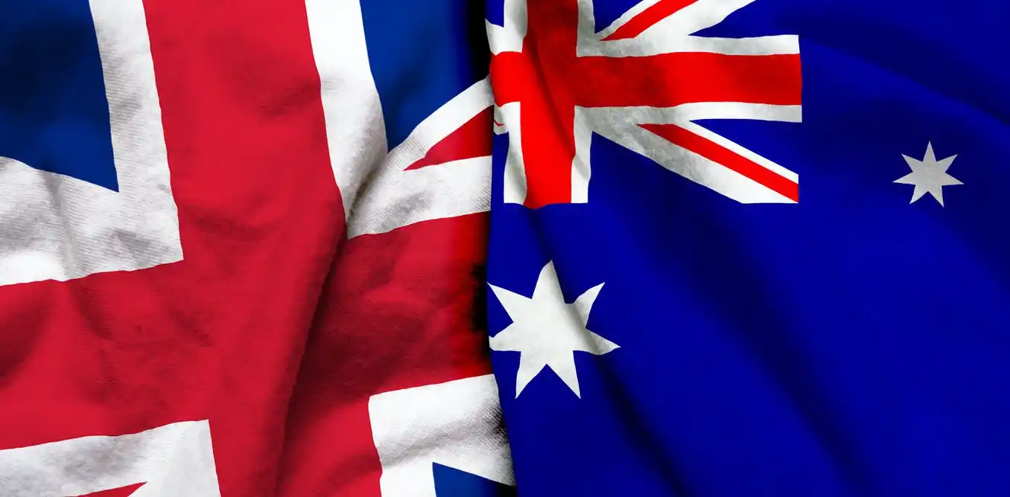

UK Trade Agreements Post-Brexit
UK- Japan Comprehensive Economic Partnership Agreement (October 2020)
  GDP long-run + 0.1%
UK-Australia Free Trade Agreement (December 2021).
  GDP long-run + 0.1%
Comprehensive and Progressive Agreement for Trans-Pacific Partnership (CPTPP)
  Australia, Brunei, Canada, Chile, Japan, Malaysia, Mexico, New Zealand, Peru, Singapore and Vietnam (China among applicants).
  500 million people and a total GDP of £11 trillion (including UK joins)
  UK annually export £60.6 bn of goods and services to the CPTPP countries (7.8% of UK total) and import £50.2 billion (5.9%).
  99% of UK goods exports to CPTPP members will be eligible for tariff-free trade
  GDP long-run + 0.08%
Notes:
UK-Japan ‘Comprehensive Economic Partnership Agreement’ – which largely mirrors the agreement Japan signed with the EU in 2019 – where the Government’s economic impact assessment suggests that it will increase the UK’s GDP by 0.1 per cent over the next 15 years (see the Government’s October 2020 UK-Japan CEPA: final impact assessment).
The free-trade agreement with Australia, the first to be concluded with a country that does not have a similar arrangement with the EU. The Government’s estimate of the economic impact is that it will raise the UK’s GDP by 0.1 per cent over 15 years (see the Government’s December 2021 UK-Australia FTA: impact assessment).
By the UK Government’s own estimates, this deal will add 0.08% to UK GDP over 10 years. This is because the UK already has bilateral FTAs with every member except Brunei and Malaysia.

Slide 29
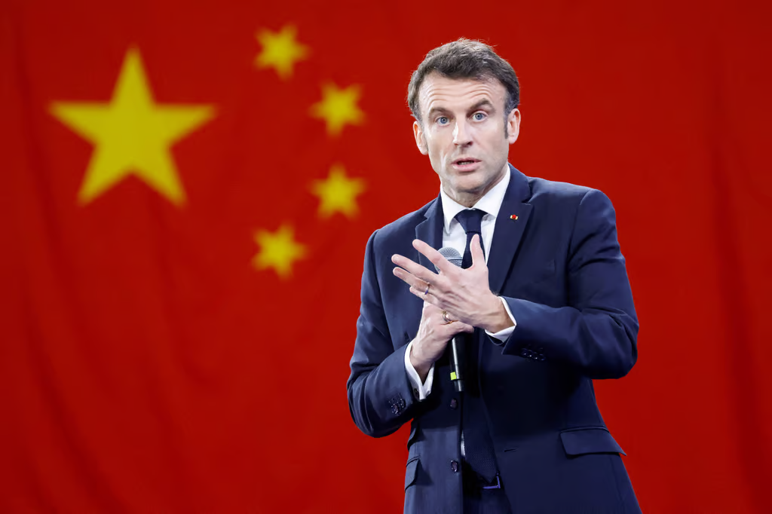
Russian invasion of Ukraine
Rapprochement
Britain’s military and intelligence strength
Russian oligarchs and sanctions
UK invited to Foreign Affairs Council meeting (March 2022)
Germany, the Netherlands and Sweden in favour, French not so keen
Europe must resist pressure to become ‘America’s followers,’ says Macron
The ‘great risk’ Europe faces is getting ‘caught up in crises that are not ours,’ French president says in interview (April, 2023).

Slide 30
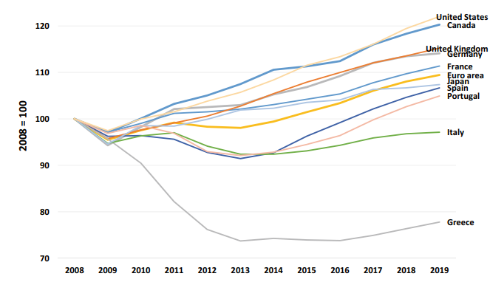
Grass isn’t very Green on the other side
Fig. 6.1 Real GDP from 2008 to 2019 (constant 2010 US$: 2008 = 100)
(Source World Bank

Slide 31
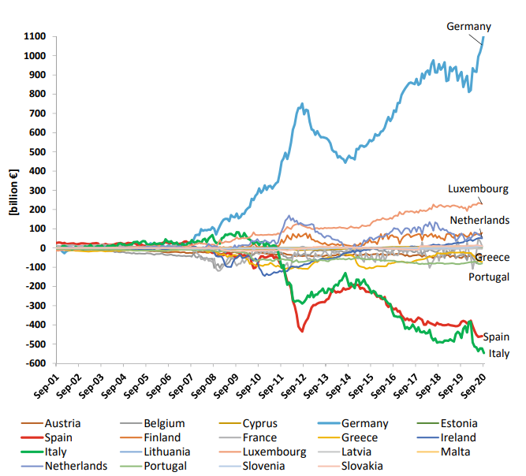
'Neither a borrower nor a lender be'
Fig. TARGET2 imbalances over two decades—Net claims on Euro system
(Source Euro Crisis Monitor, Institute of Empirical Economic Research, Osnabrück University

Slide 32
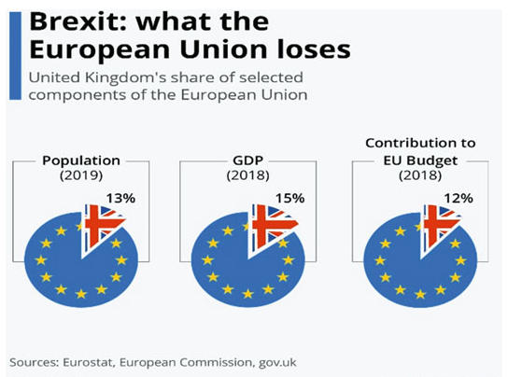
Brexit: what the European Union loses

Slide 33
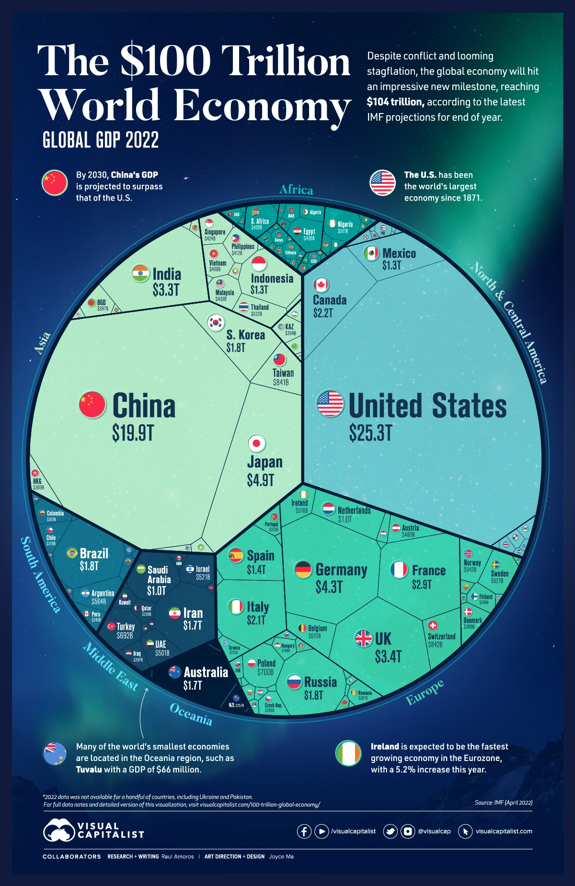
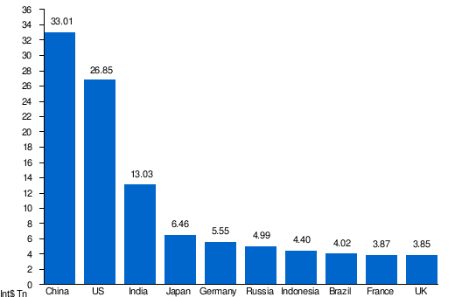
Global Unreal Pie
Source: World Economic Outlook database: April 2023 (PPP)

Slide 34
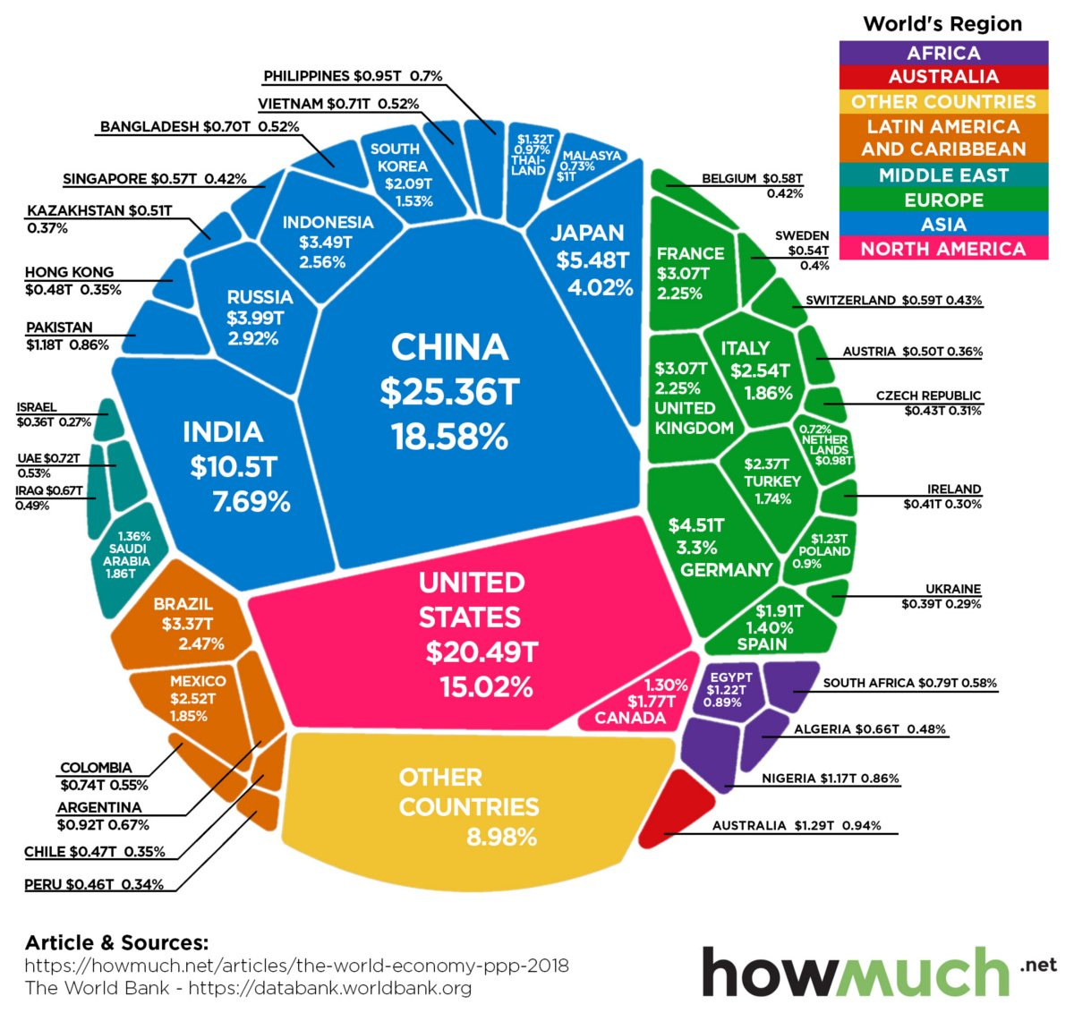

Slide 35
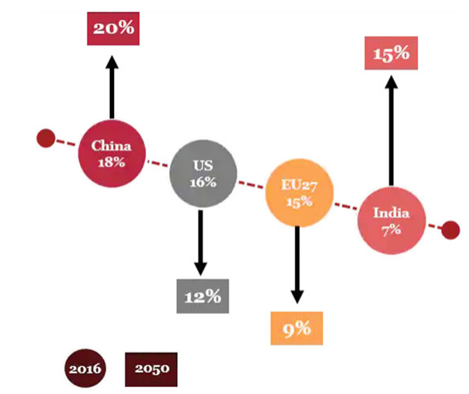
Changing Share
Changing share of world GDP (PPP) from 2016 to 2050
Source: IMF estimates for 2016 and PWC projections for 2050

Slide 36
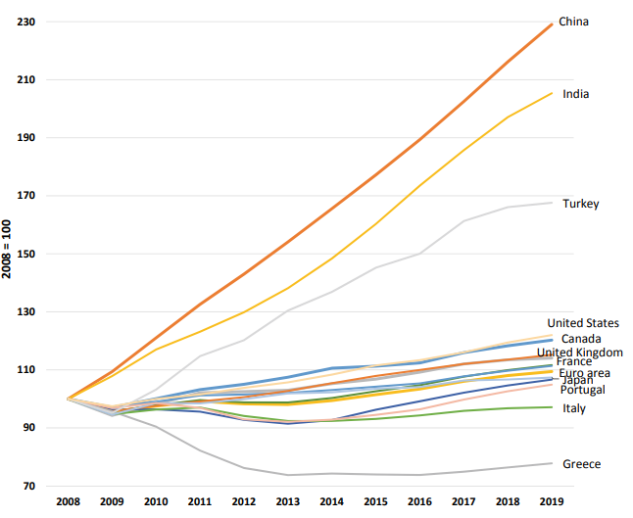
Real GDP growth Eurozone and emerging world (constant 2010 US$, Year 2010 = 100)
Source: Authors’ calculations using data from World Bank

Slide 37
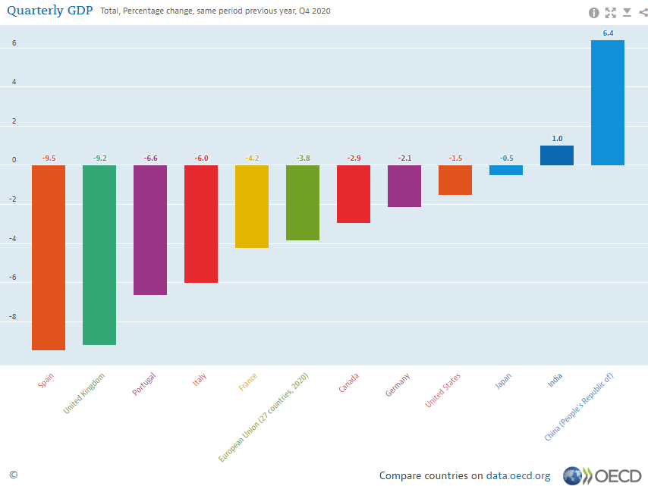
Resilience - 2020 Q4 vs. 2019 Q4

Slide 38

Should or would UK Re-join ?
Article 49: re-joining the EU
  Be a European state
  Respect and commit to promote Article 2 values – including human dignity, freedom, democracy, equality, the rule of law, human rights (specifically minority rights), pluralism, non-discrimination, tolerance, justice, solidarity and equality
  Have its application unanimously approved by the Council of the EU
  Have its application approved by a majority vote of the European Parliament
1993 Copenhagen criteria
  Political: Broadly the same values as those outlined in Article 2, with an additional requirement for sound institutions and robust checks and balances
  Economic: A functioning and resilient market economy
  Administrative and institutional: Capacity to implement and absorb the EU’s acquis, i.e. the full sum of EU law

Slide 39
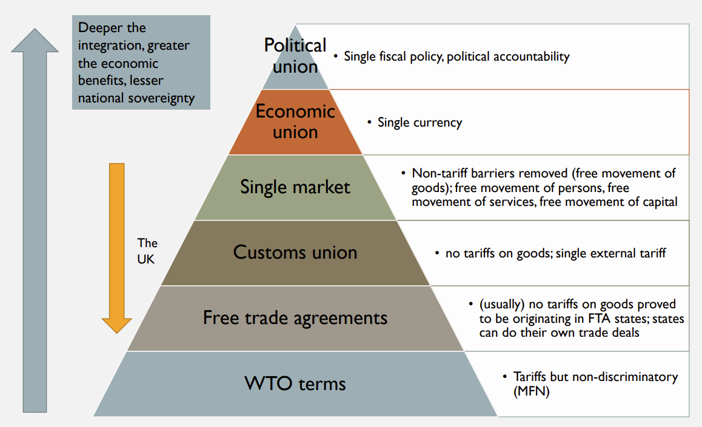
Likelihood of a UK Application’s Success
UK’s economic eligibility, level playing field rules to the EU, protectionist industrial policy and EU state aid rules
Legal divergence
Support of MEPs.
French veto ☹
Post- Brexit polls
EU moved on
  Multiannual Financial Framework (2021-2027) long-term EU budget & Next-Generation-EU
  €1824.3 billion (€ 750 billion of NextGenerationEU) € 219bn
  US Inflation Reduction Act/ EU Net Zero Industry Act
Sunak wants EU passport checks deal (Bloomberg)
Re-joining EU science projects (Horizon Europe etc. )
Indivisibility of Single market vs. Differentiated Integration (Cherry picking) ?
Notes:
https://yaleconnect.yale.edu/get_file?eid=f3c017c9706bf81b79f5e857b6e3d132
https://oxfordre.com/politics/display/10.1093/acrefore/9780190228637.001.0001/acrefore-9780190228637-e-1148;jsessionid=090F6E7E01827620D77623906ED34944
https://www.politico.eu/article/uk-weighs-value-for-money-of-returning-to-eu-science-after-brexit-hiatus/

Slide 40
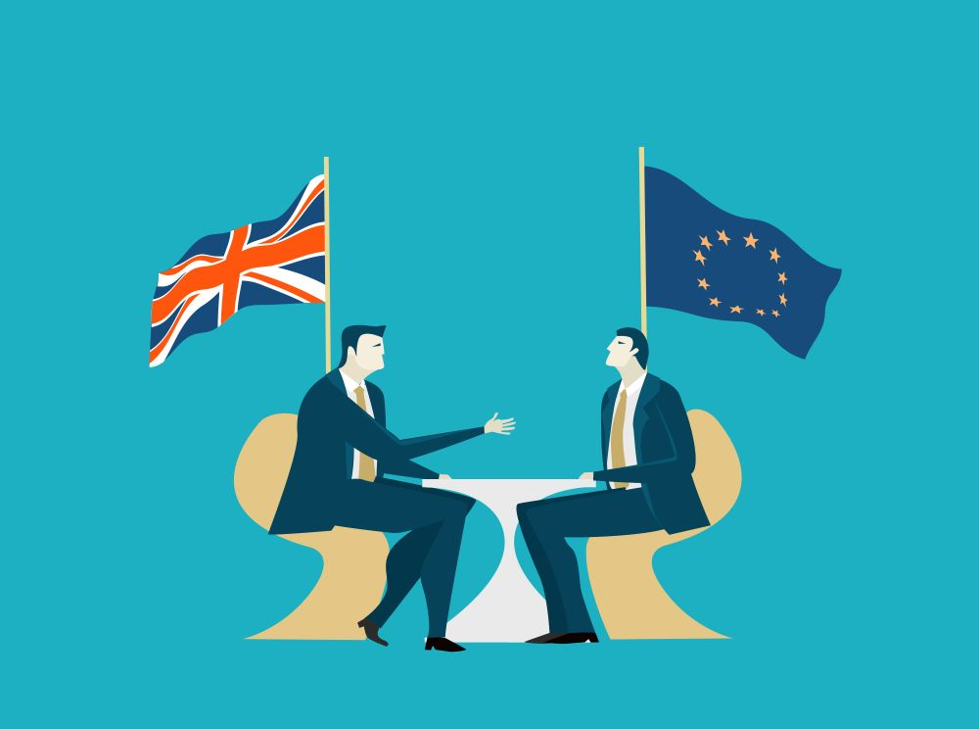
" WE MUST HANG TOGETHER OR SURELY WE SHALL HANG SEPARATELY“
                (Benjamin Franklin)

Slide 41
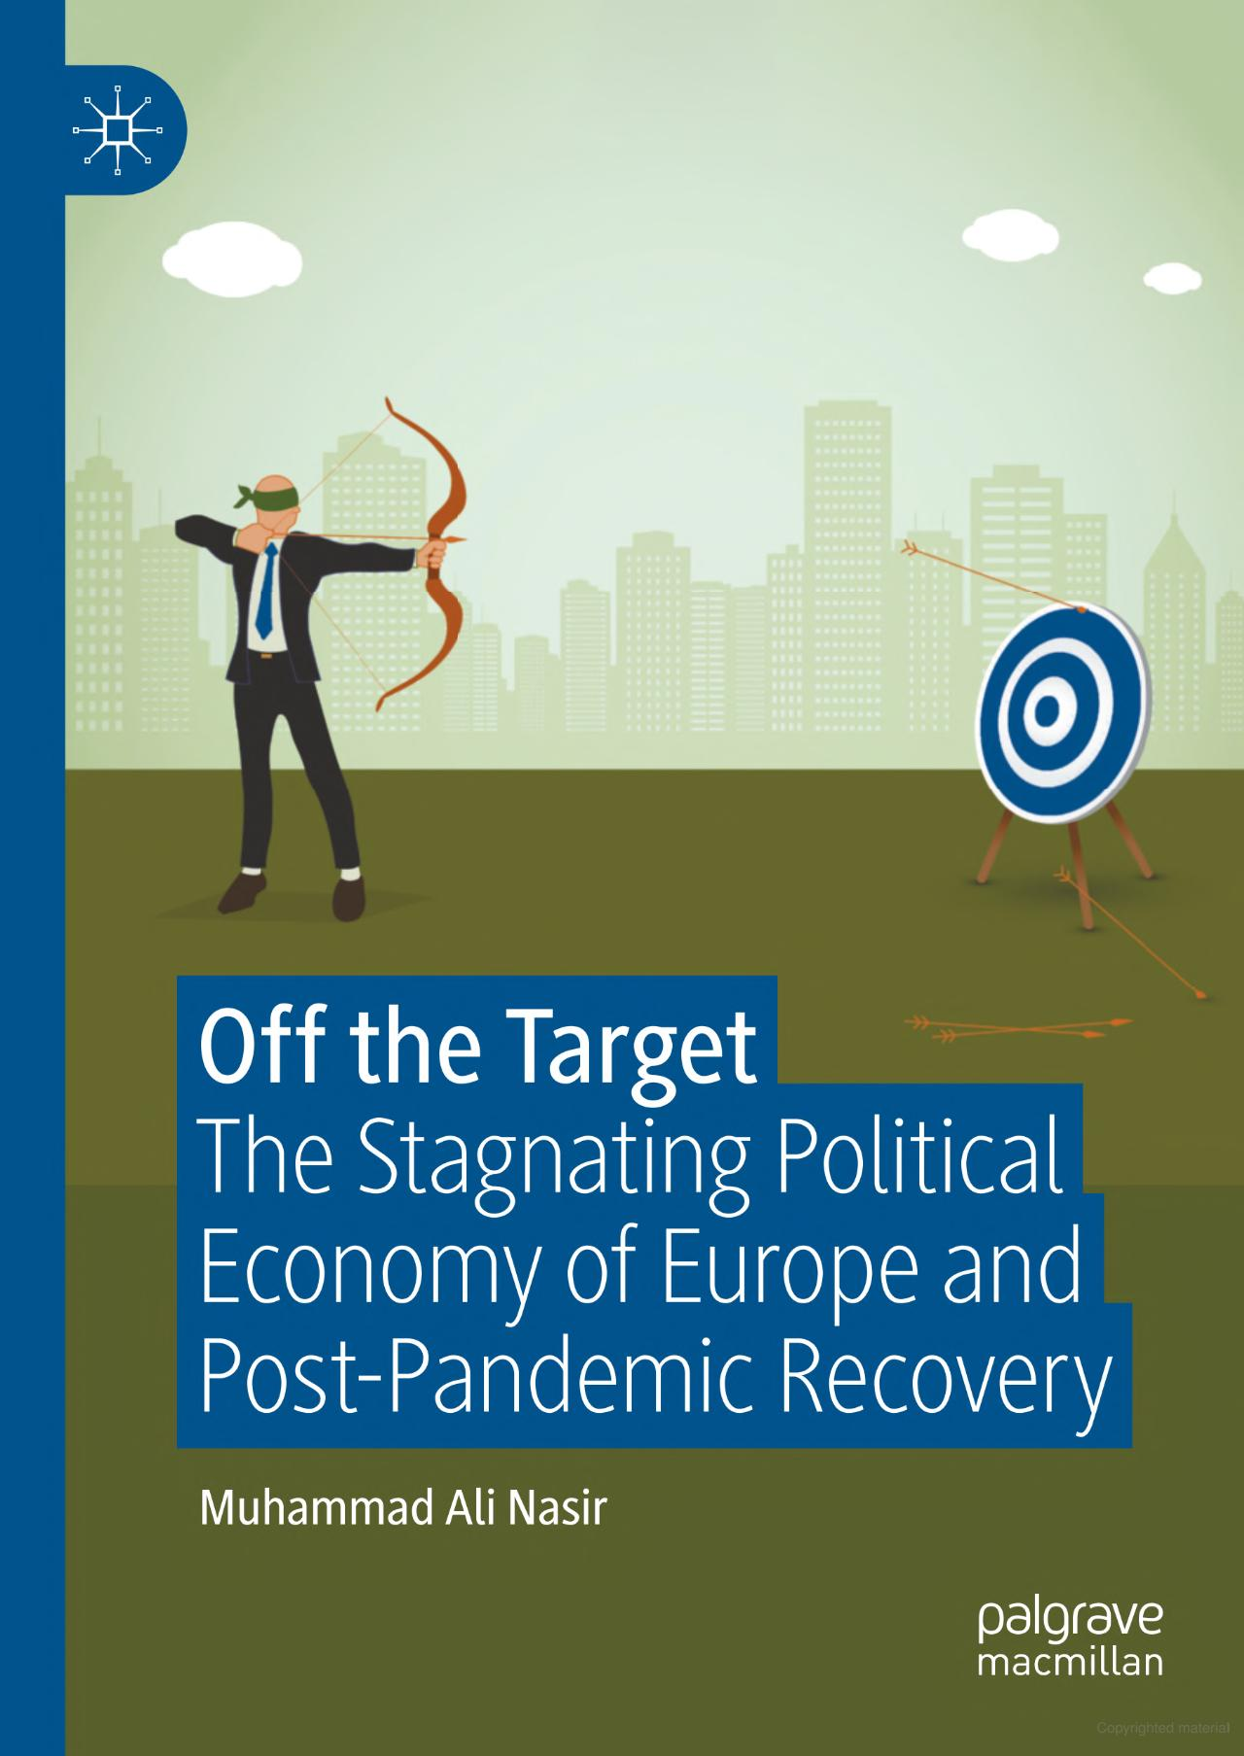
Thank You!

